Slide 1

Reporting & analytics
Informatics environment
Care management – CMUI | CM360

Slide 2
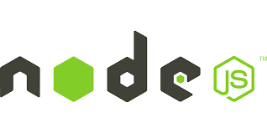


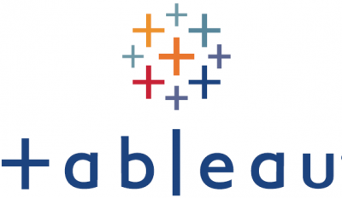
Agenda | one hour deep DIVE video
Care Management Use Case Summary - 5 min
CMUI - Load & Strat - 15 min
  Node.JS Web Application
  API using Loopback
  Single Sign-on Integration
  Use Case / Benefits
CM360 - Member Profile - 30 min
  Tableau Dashboard Integration
  Data solutions for each tab
  Query Optimization / Extracts
  Usage
  Performance
Methodology & Approach - 2 min
Lessons Learned - 2 min
Business Testimonials - 2 min

Slide 3
Care management

Slide 4
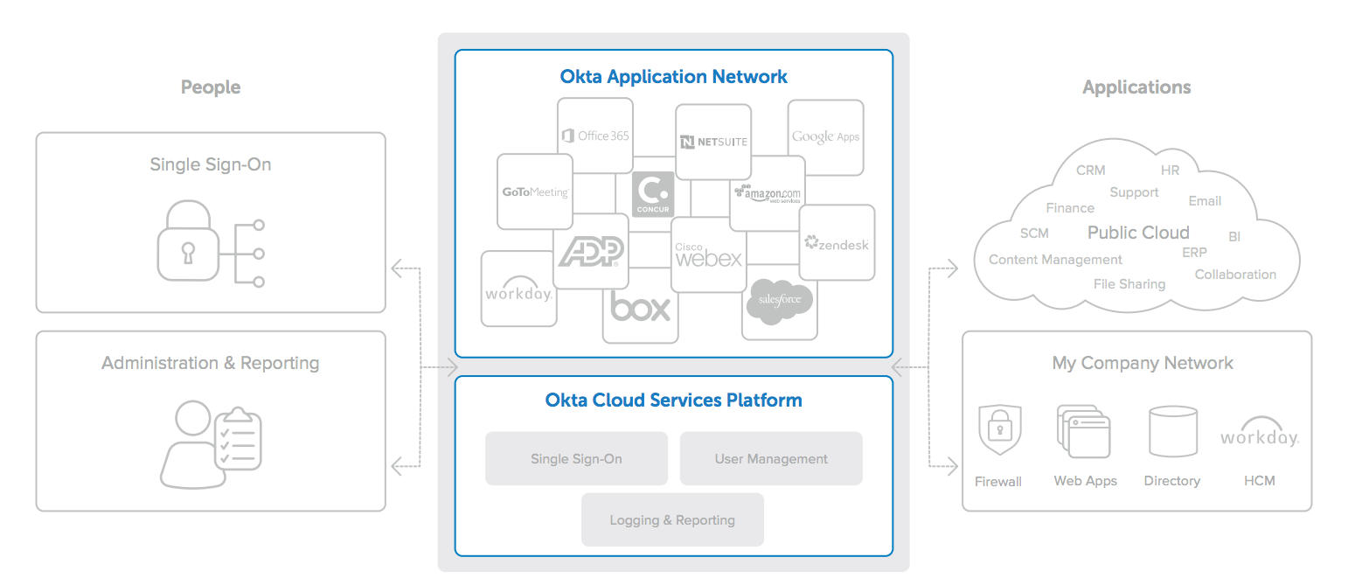
Single sign-on

Slide 5
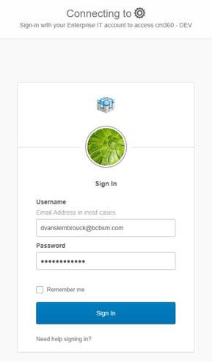
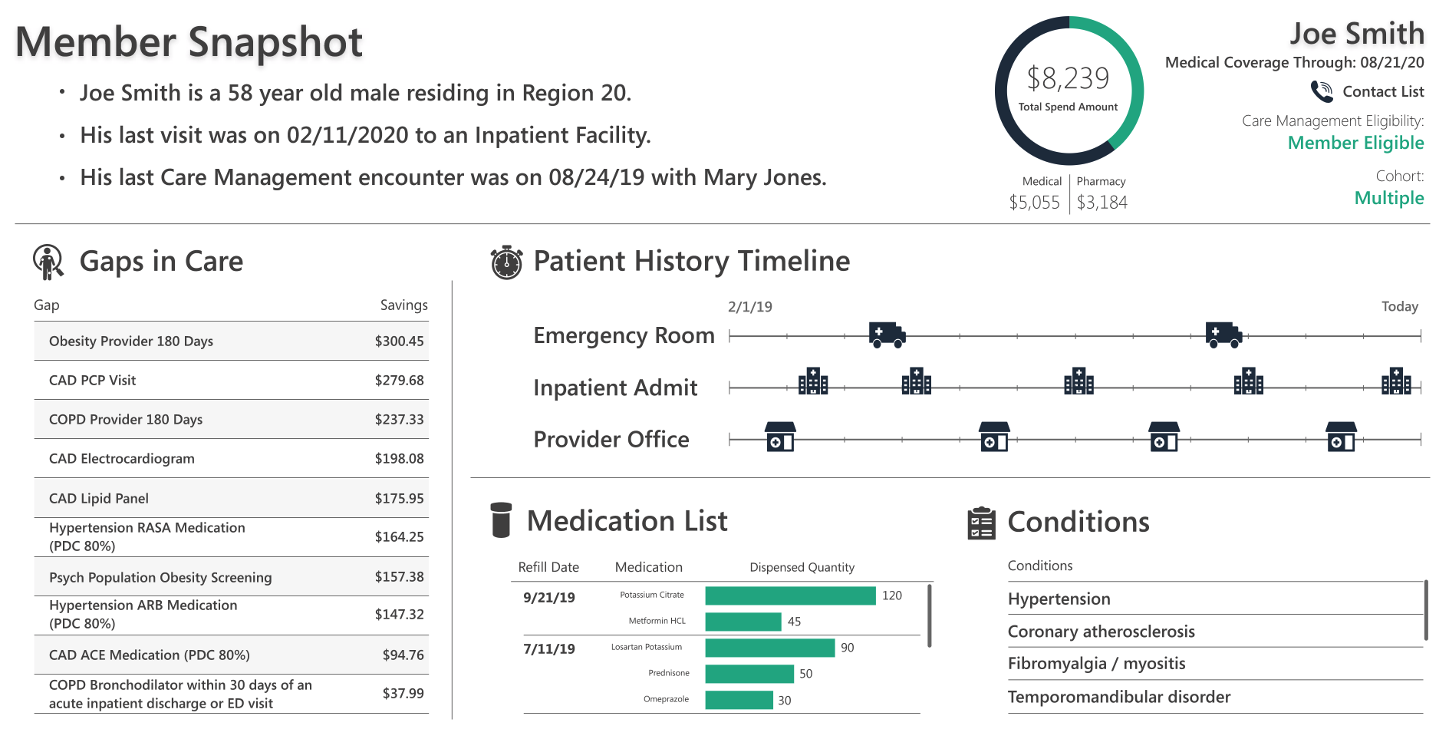
Single sign-on CM360
SAML GATEWAY
Tableau AUTH
CONF, SSL, AUTH (META DATA)
/app dir/saml/sso
PERSON ID, CONTRACT ID, TICKET
pass through via token

Slide 6
Cmui technology stack
SimpleSAMLphp is simple library application written in native PHP that deals with authentication. The project is led by UNINETT, has a large user base, a helpful user community and a large set of external contributors. The main focus of SimpleSAMLphp is providing support for: SAML 2.0 as a Service Provider (SP), SAML 2.0 as an Identity Provider (IdP)
Node.js® is a JavaScript runtime built on Chrome's V8 JavaScript engine. As an asynchronous event-driven JavaScript runtime, Node.js is designed to build scalable network applications. HTTP is a first-class citizen in Node.js, designed with streaming and low latency in mind. This makes Node.js well suited for the foundation of a web library or framework.
Bootstrap UI Framework. Quickly design and customize responsive mobile-first sites with Bootstrap, the world’s most popular front-end open source toolkit, featuring Sass variables and mix ins, responsive grid system, extensive prebuilt components, and powerful JavaScript plugins.
Loopback is a highly extensible Node.js and TypeScript framework for building APIs and microservices. It is an OpenAPI Spec Driven REST API that allows you to create powerful APIs easily with a new creation experience for defining REST API's and handling API requests/responses.
PostgreSQL, also known as Postgres, is a free and open-source relational database management system emphasizing extensibility and SQL compliance. PostgreSQL is a powerful, open source object-relational database system with over 30 years of active development that has earned it a strong reputation for reliability, feature robustness, and performance.

Slide 7
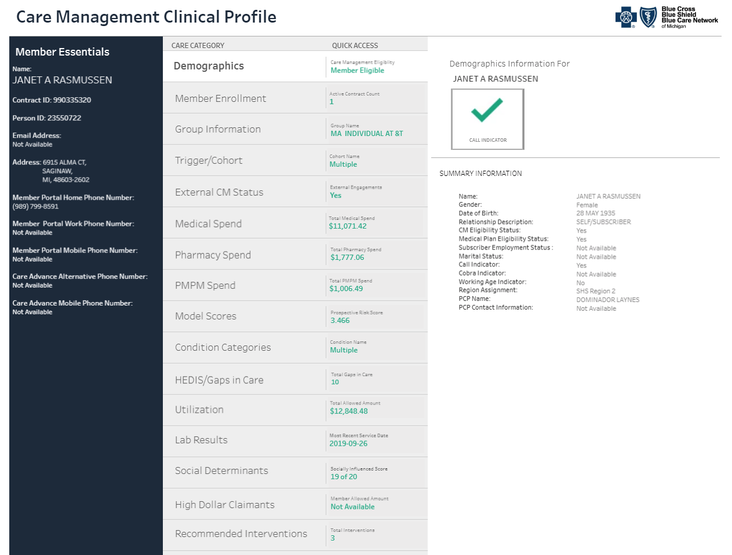
Care management clinical profile (cm360)

Slide 8
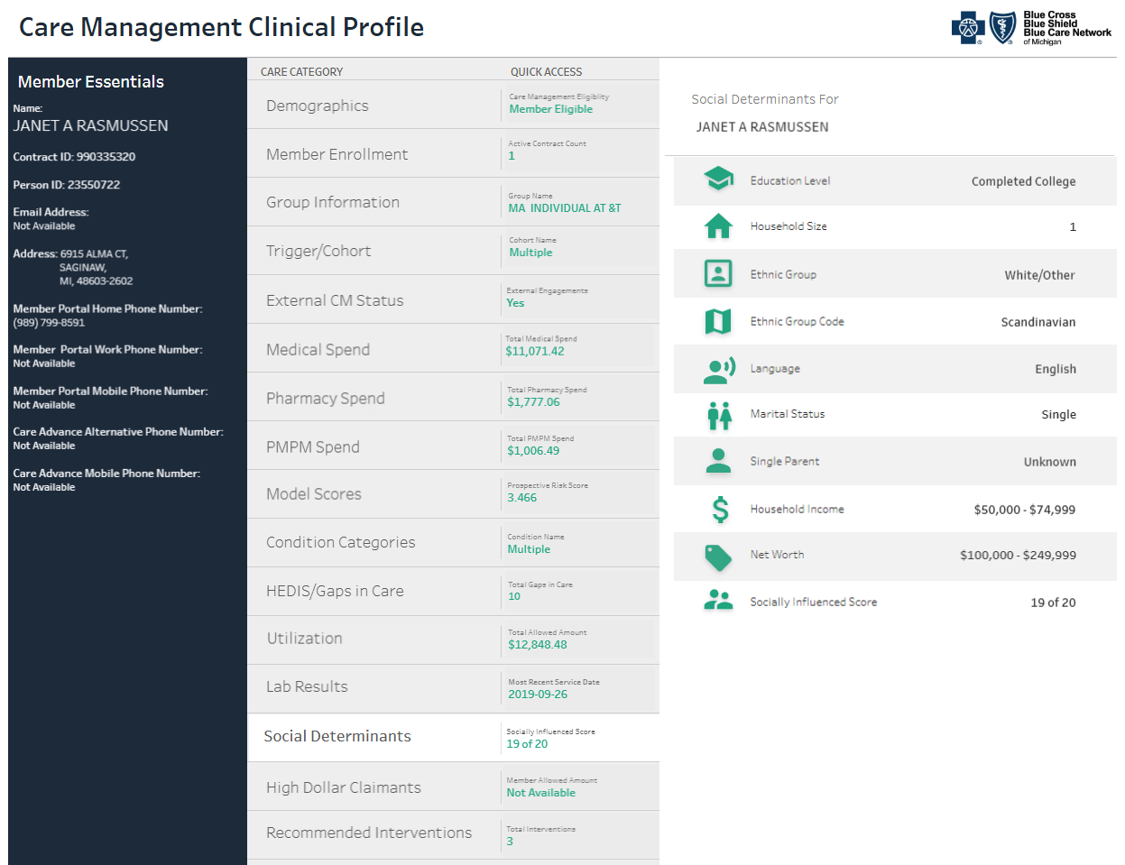
Care management clinical profile (cm360)

Slide 9
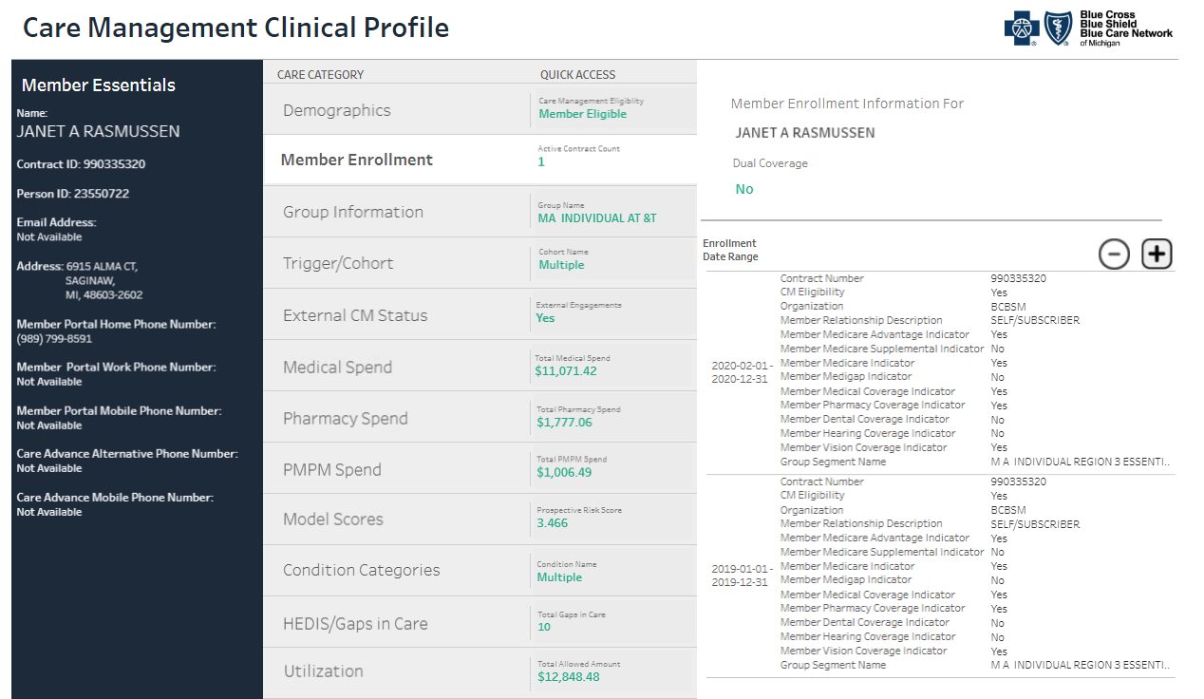
Care management clinical profile (cm360)

Slide 10
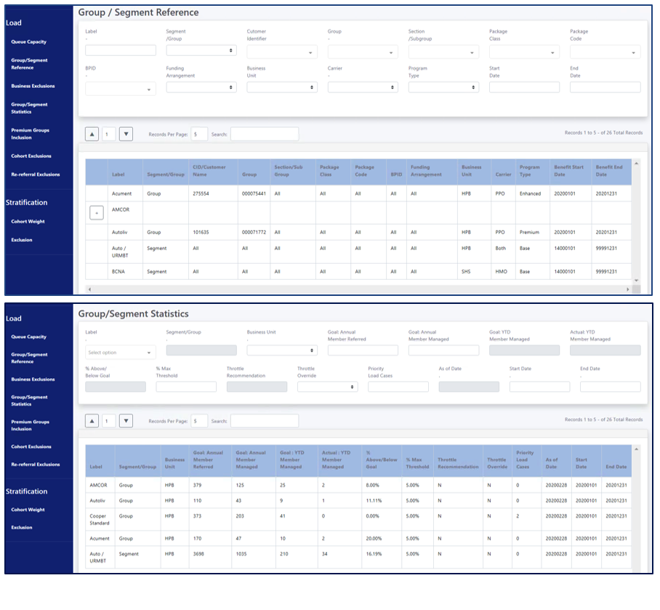
Care management admin screens
The Care Management Admin Screens are built to facilitate the loading and stratification of Care Management members for eligibility in the Care Management Programs.
This custom UI solution was designed, developed and deployed by the IT team in our Web Application Environment by partnering with the business and aligning to their need to create a custom solution.

