Slide 1

Reporting & analytics
Informatics environment

Slide 2
AGENDA
Start with why
Use case summary
Dashboard deep dive
Methodology
Lessons learned
Closing comments
5MIN
20MIN
20MIN
5MIN
2MIN
2MIN

Slide 3
AGENDA
Start with why

Slide 5
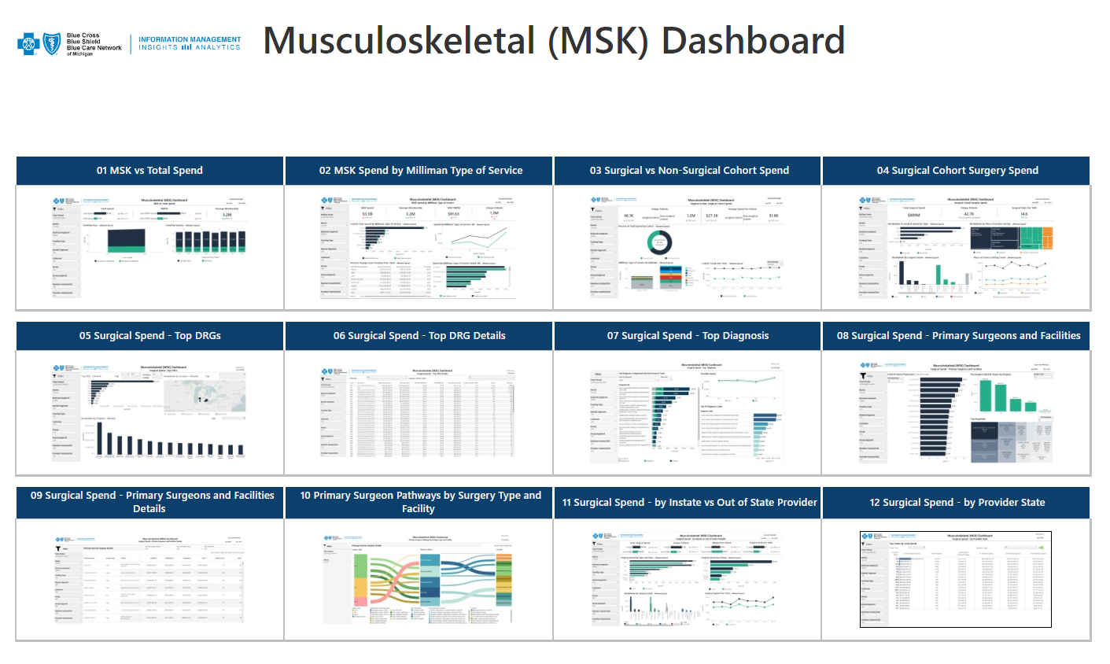
MUSCULOSKELETAL (MSK) DASHBOARD – Landing Page

Slide 6
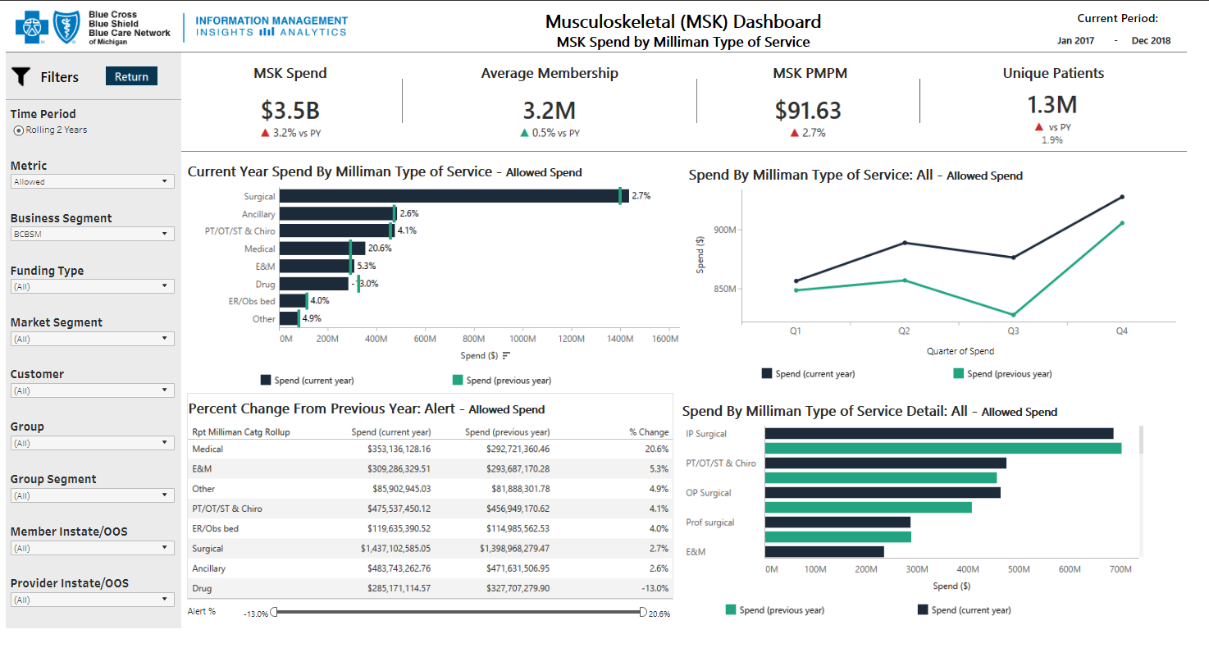
MSK Dashboards

Slide 7
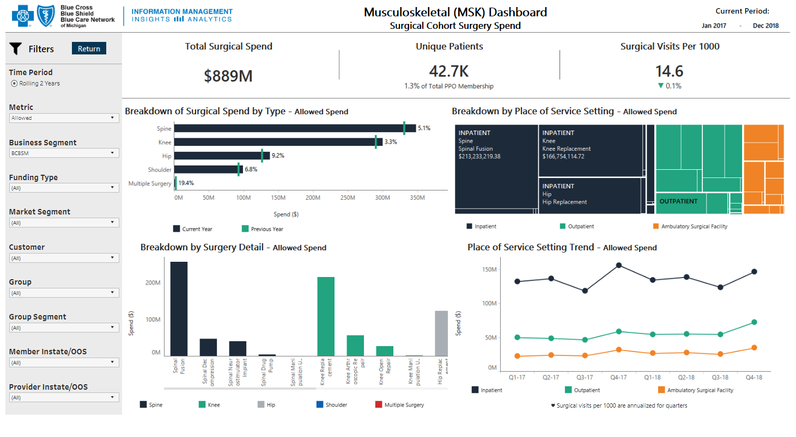
MSK Dashboards

Slide 8
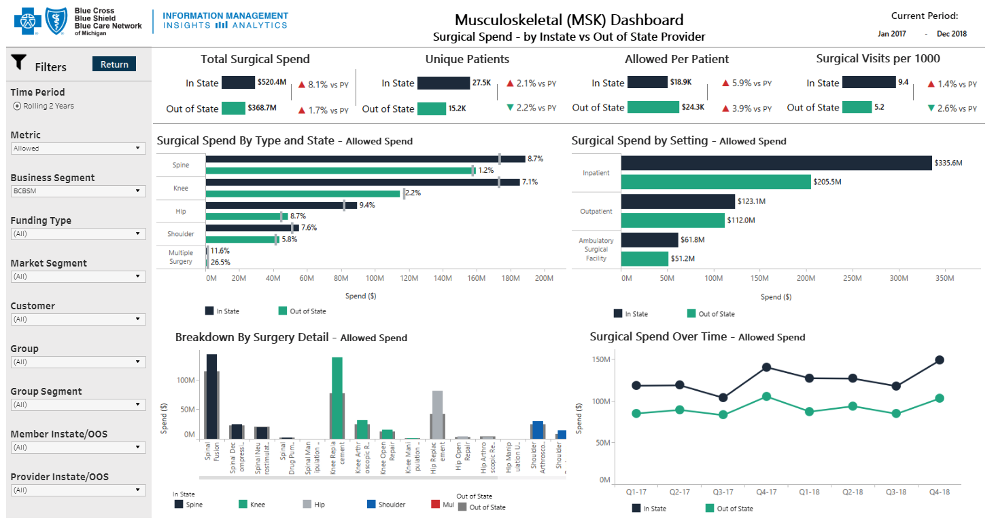
MSK Dashboards

Slide 9
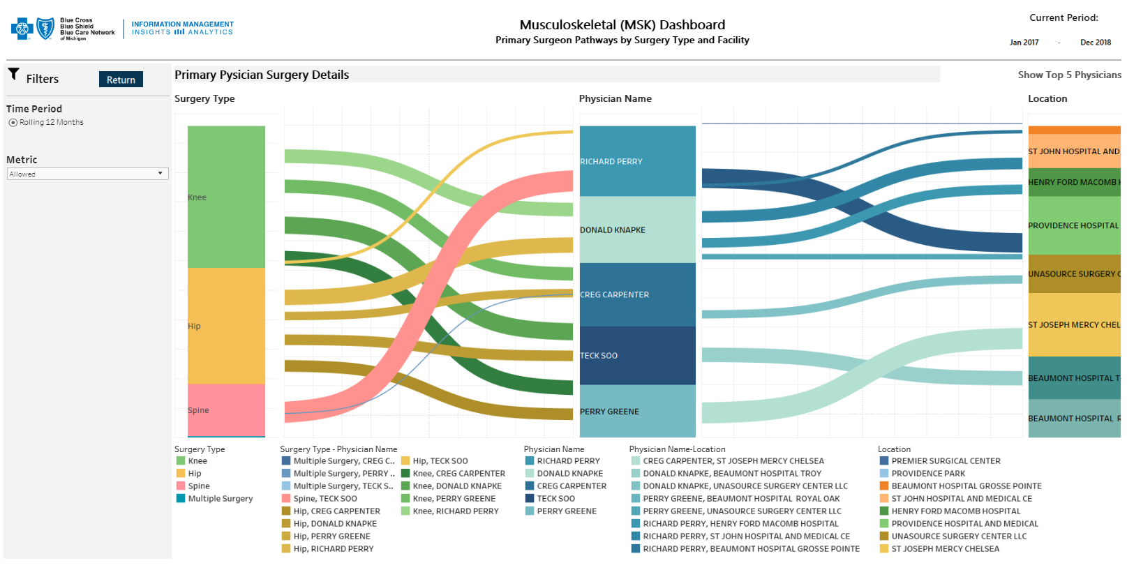
MSK Dashboards

Slide 10
AGENDA
Start with why
Use case summary
Dashboard deep dive
Methodology
Lessons learned
Closing comments
5MIN
20MIN
20MIN
5MIN
2MIN
2MIN

