Slide 1

Reporting & analytics
Informatics environment
Portfolio 2020

Slide 2
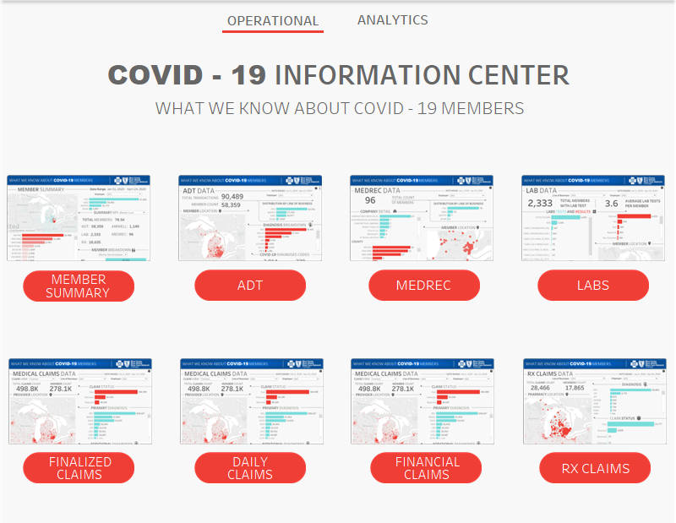
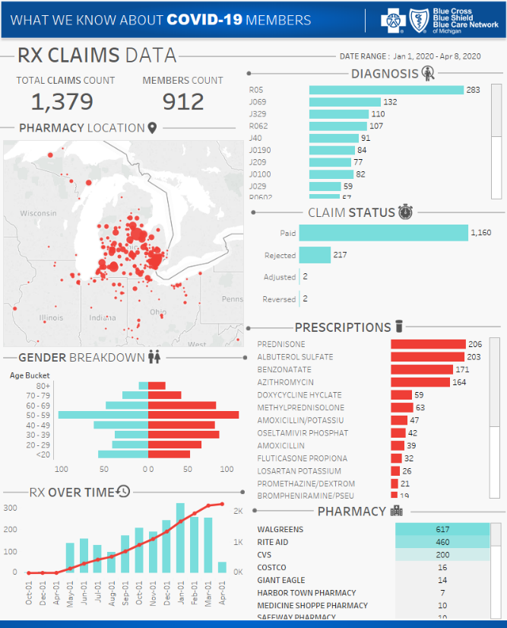
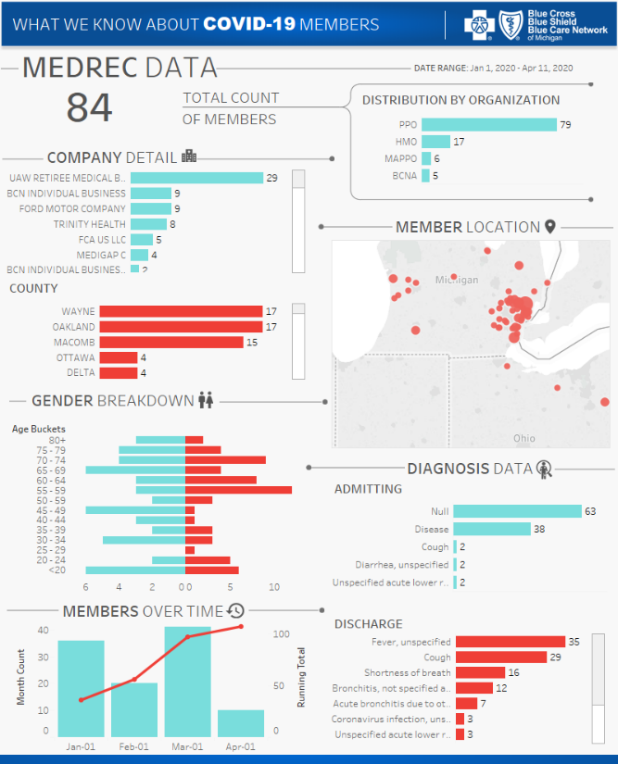
Covid-19

Slide 3
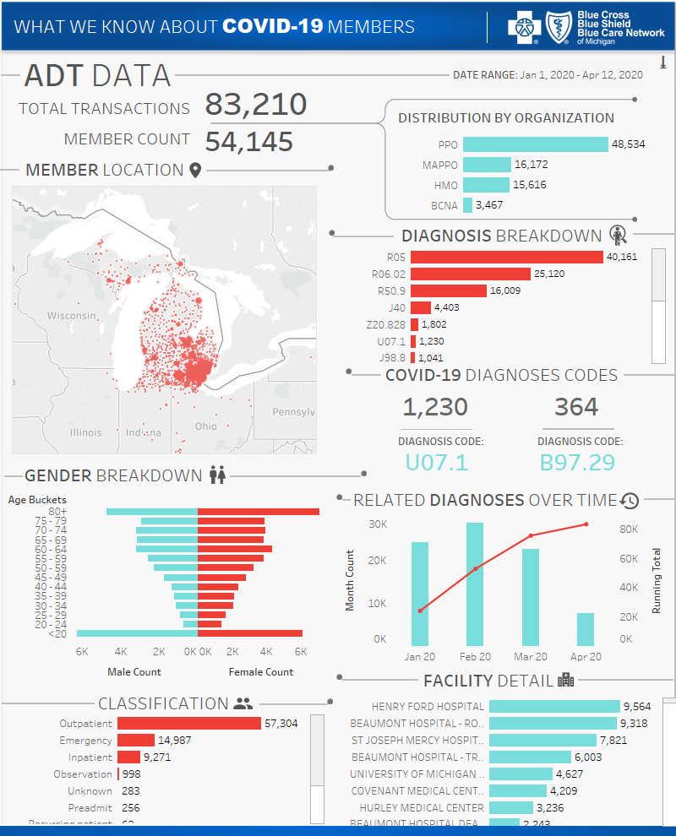
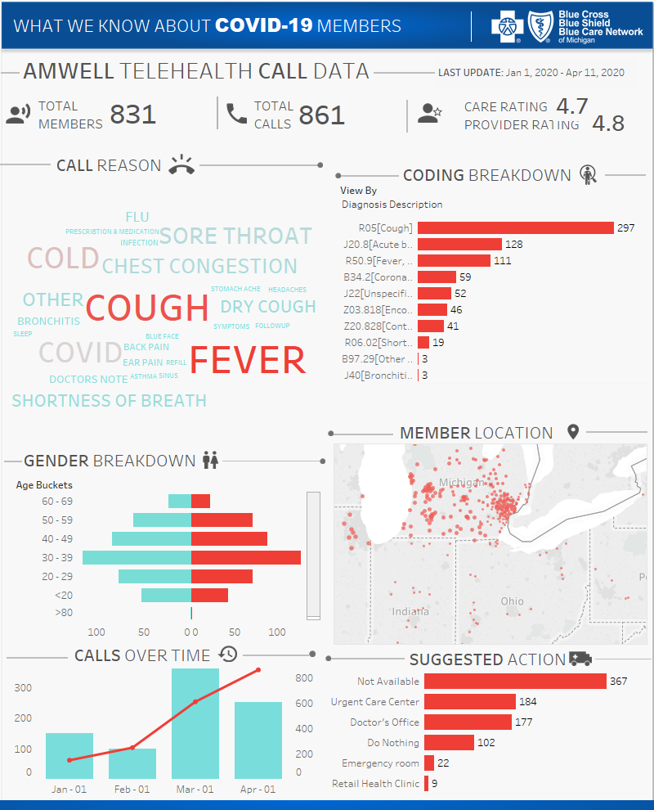
Covid-19

Slide 4
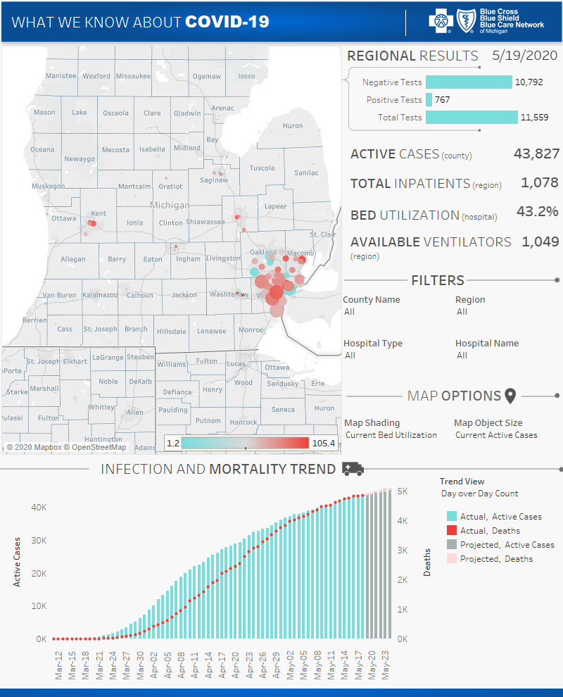
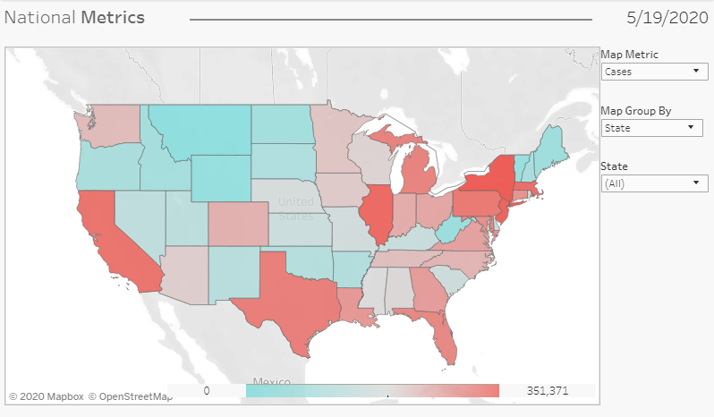
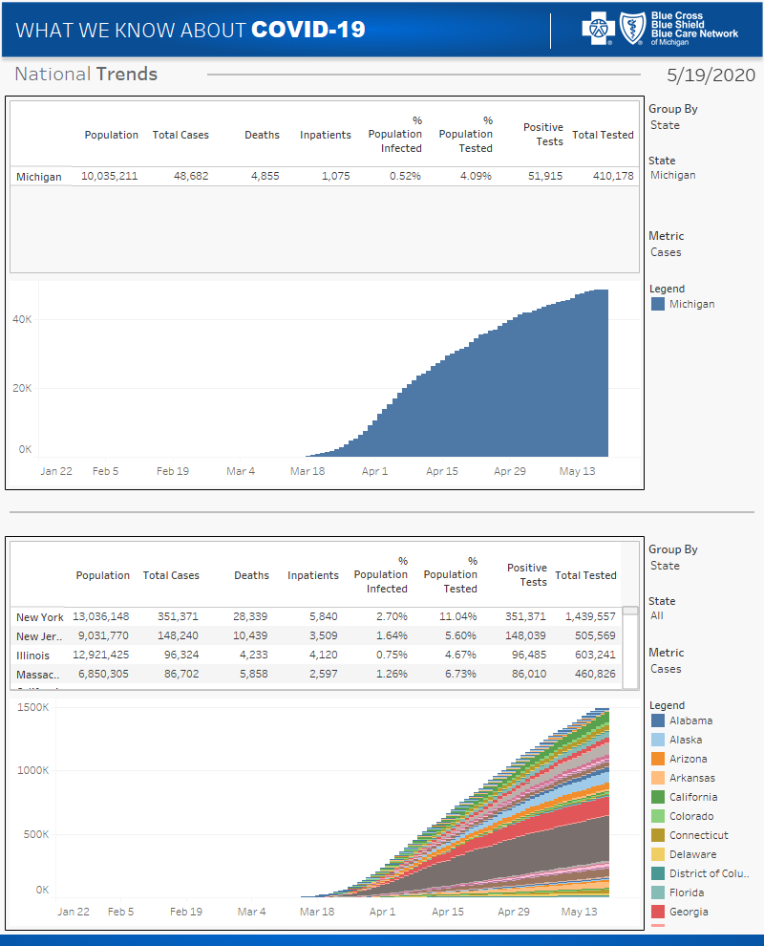
Covid-19

Slide 5
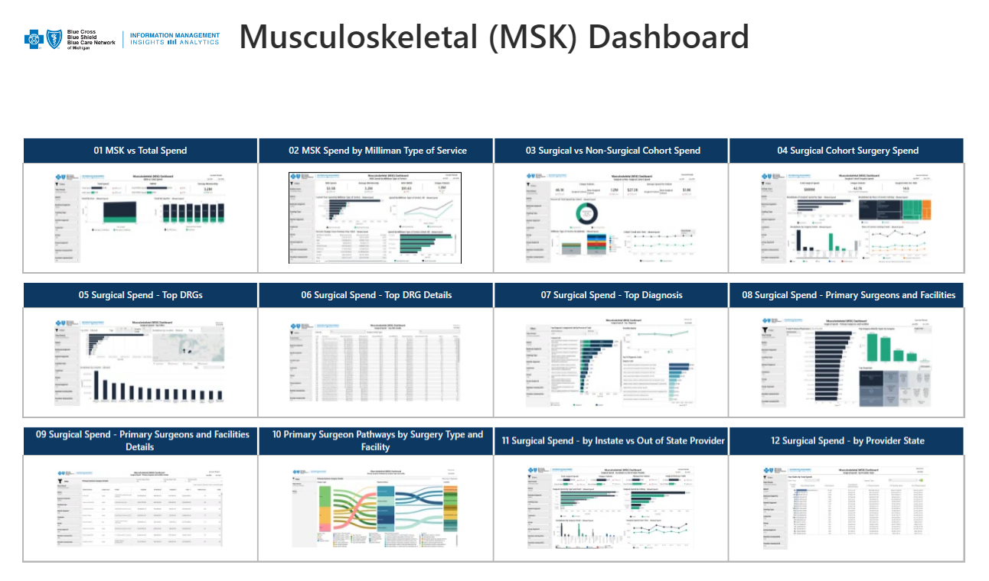
MSK Dashboards - executive summary / landing zone

Slide 6
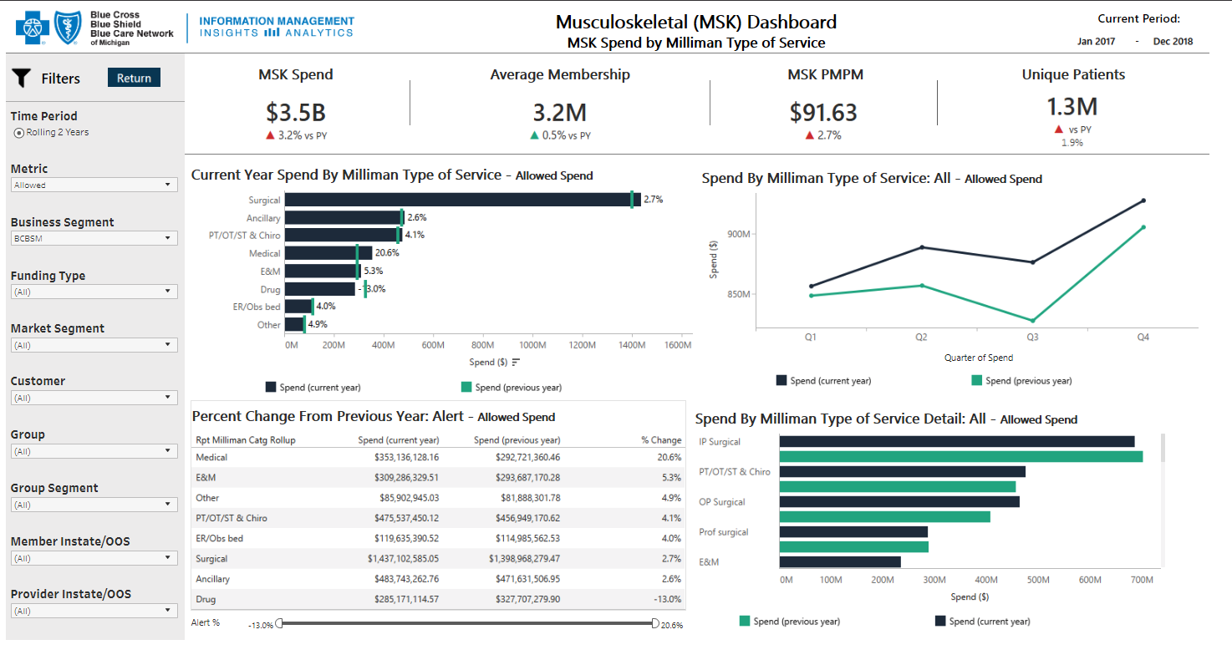
MSK Dashboards

Slide 7
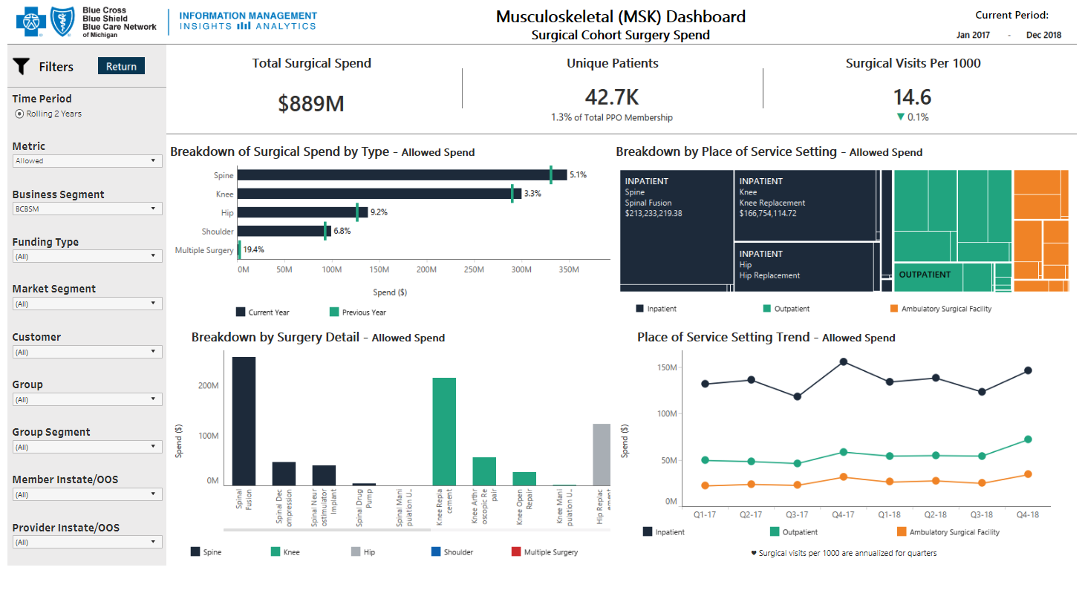
MSK Dashboards

Slide 8
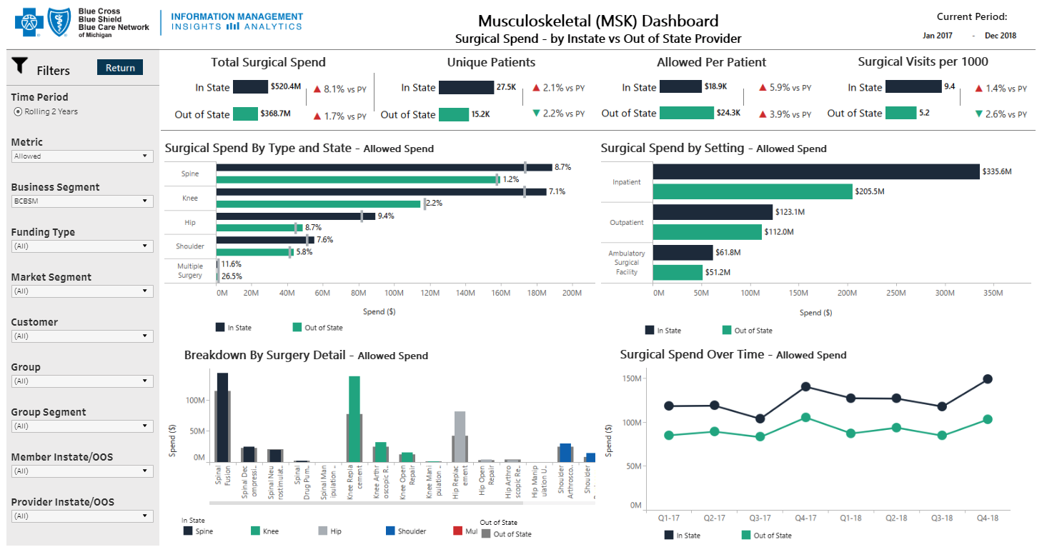
MSK Dashboards

Slide 9
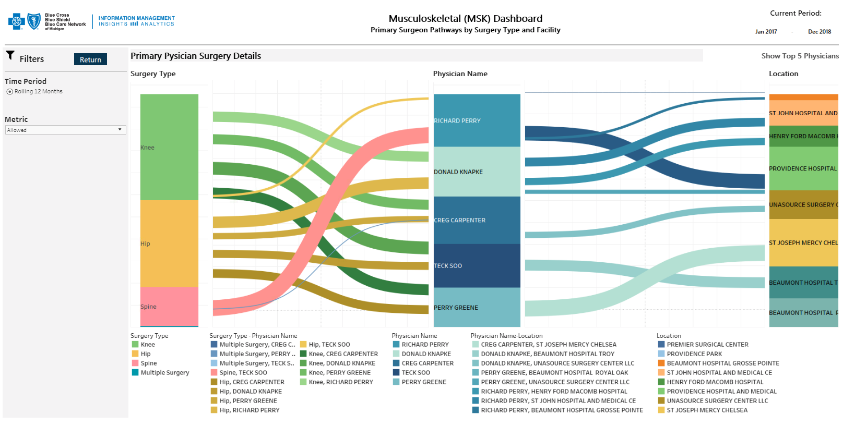
MSK Dashboards

Slide 10
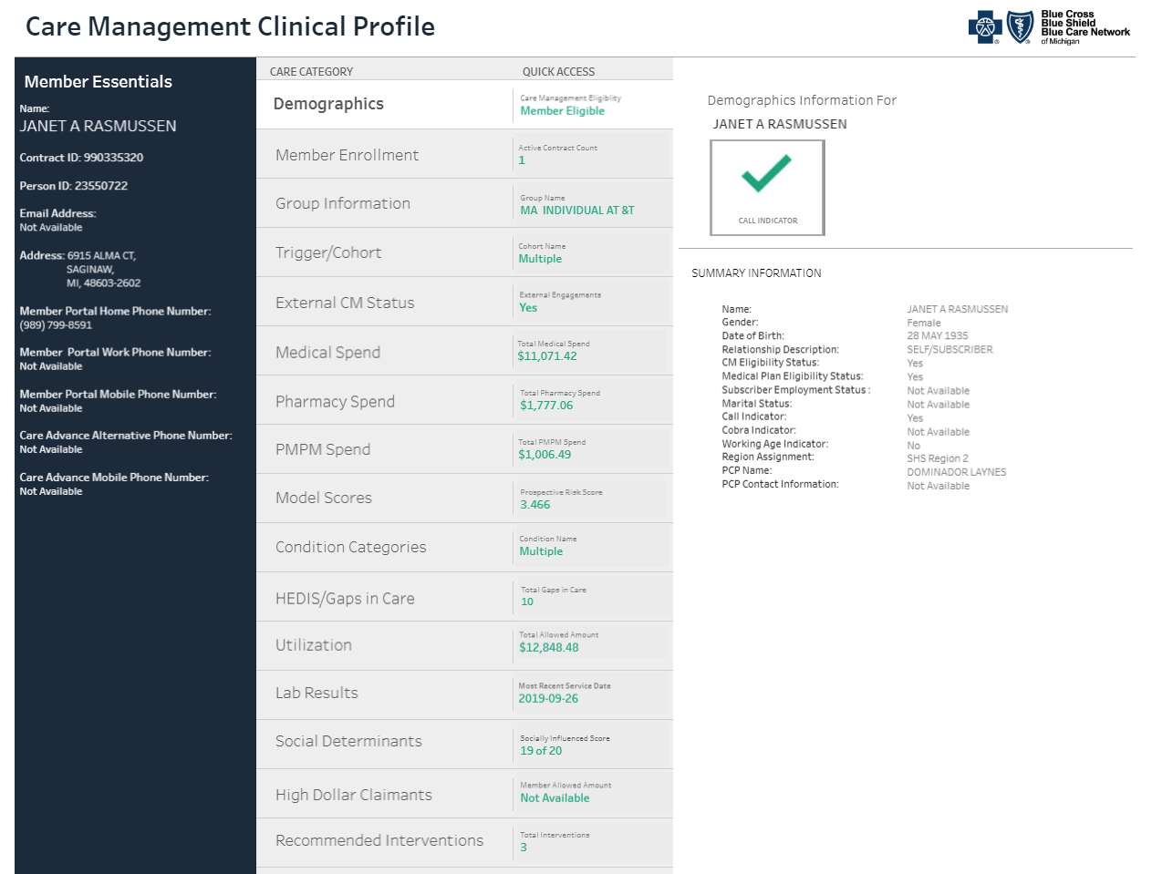
Care management clinical profile (cm360)

Slide 11
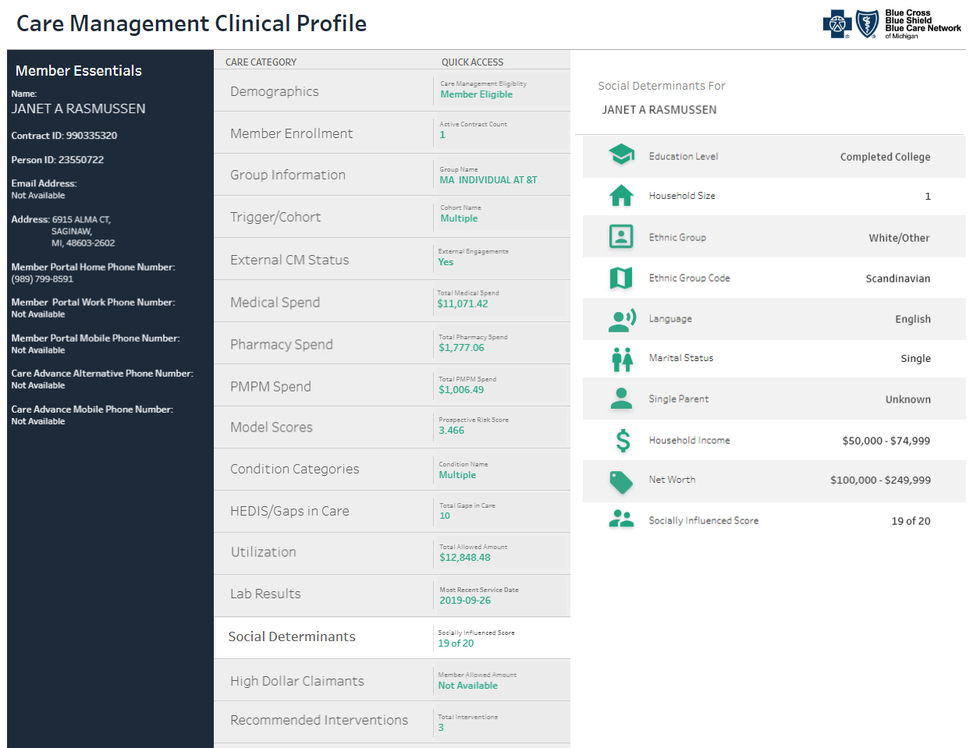
Care management clinical profile (cm360)

Slide 12
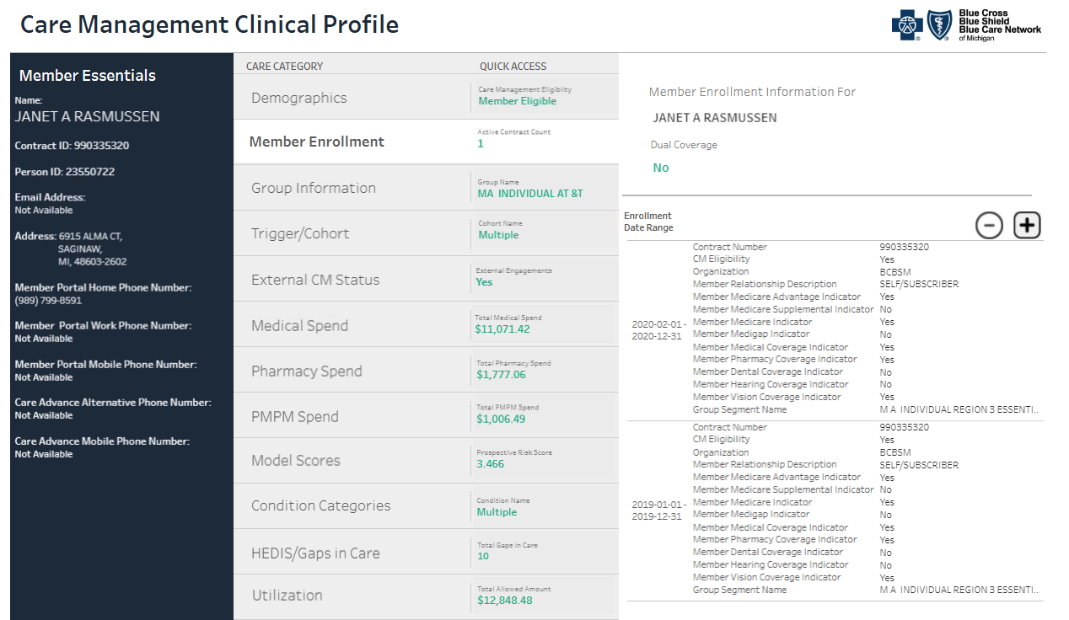
Care management clinical profile (cm360)

Slide 13
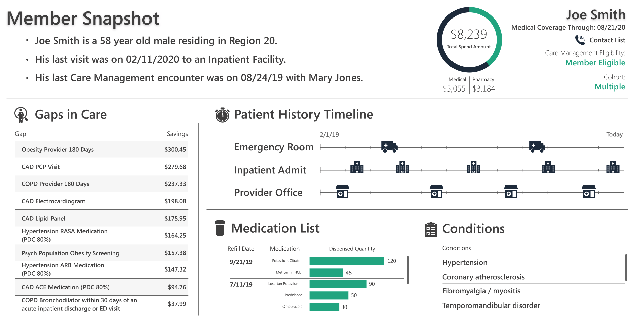
Care management clinical profile (cm360) member summary

Slide 14
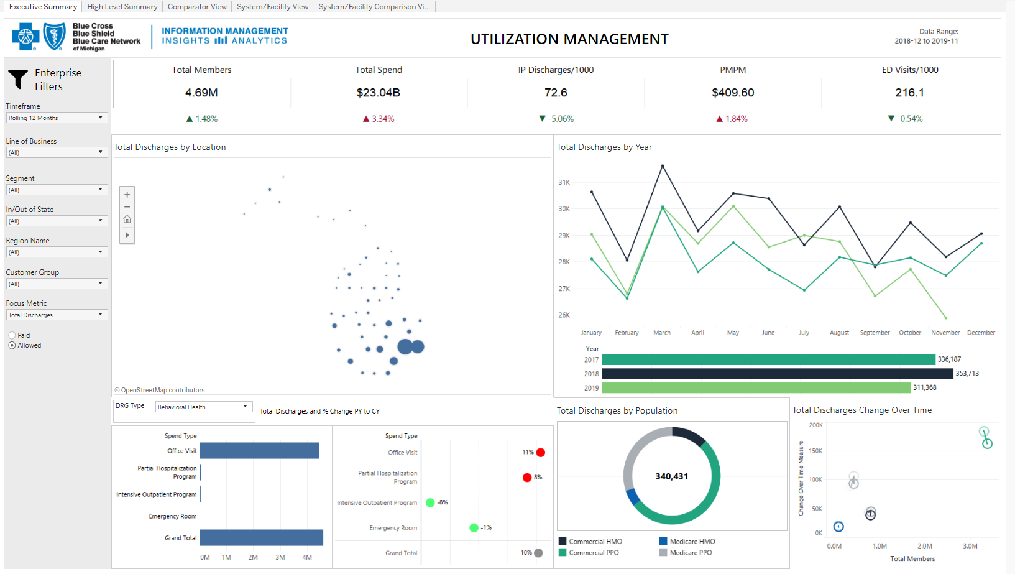
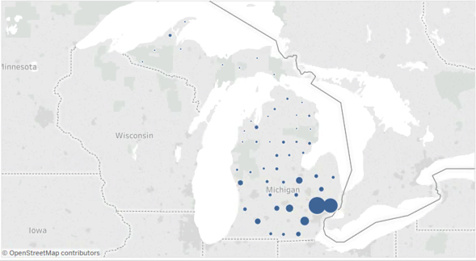
Utilization management

Slide 15
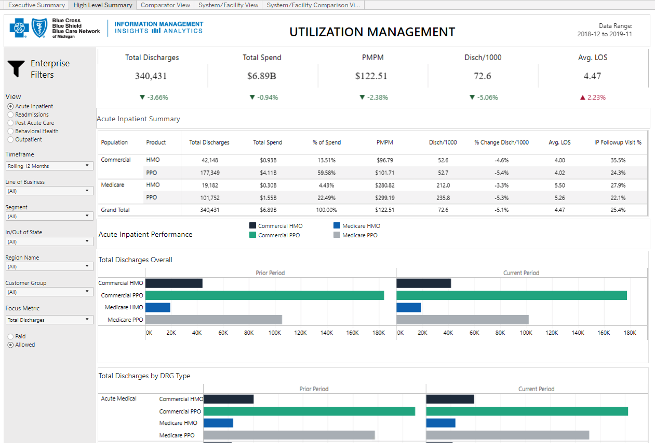
Utilization management

Slide 16
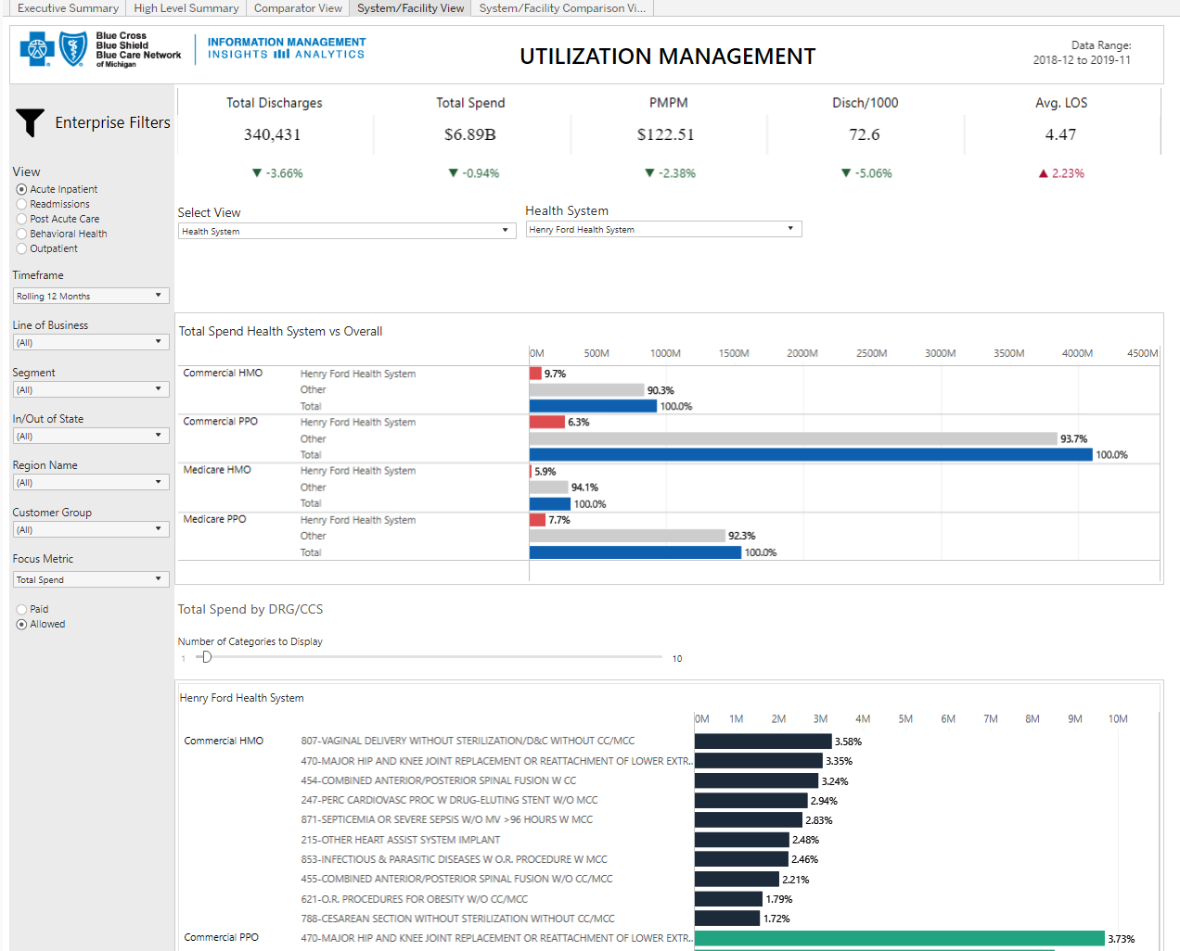
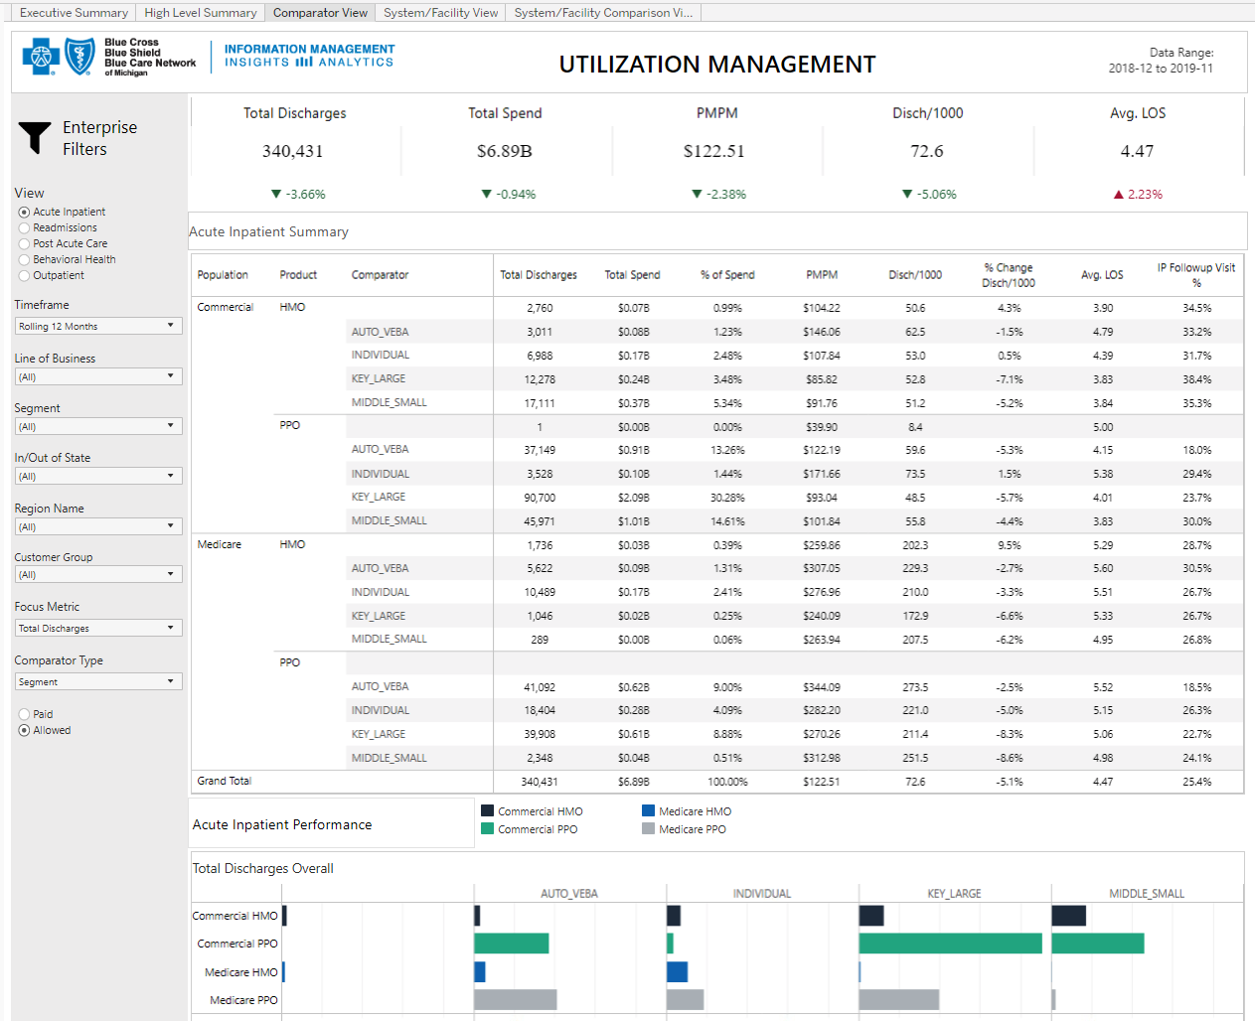
Utilization management

Slide 17
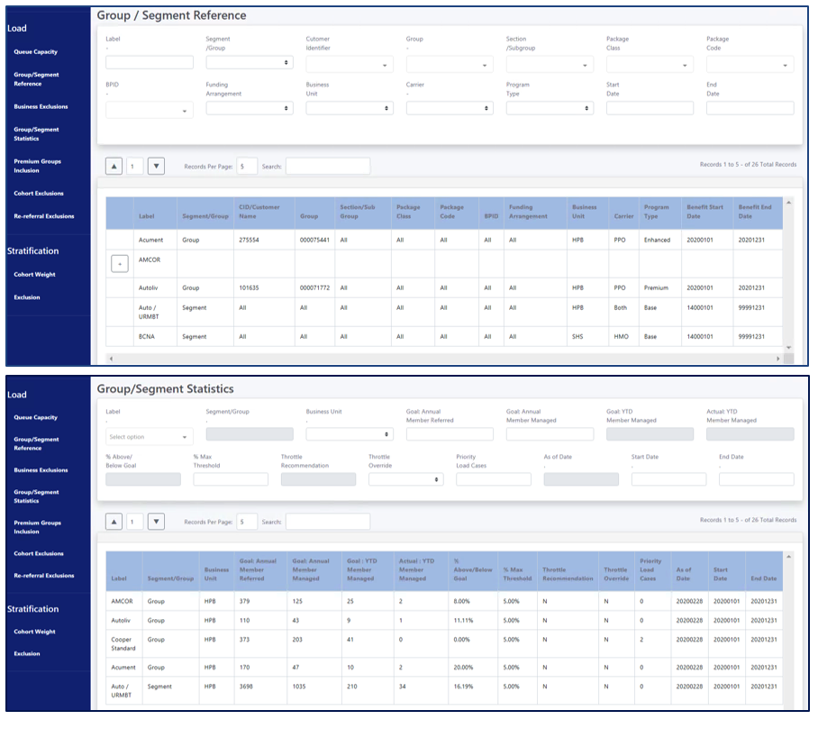
Care management admin screens
The Care Management Admin Screens are built to facilitate the loading and stratification of Care Management members for eligibility in the Care Management Programs.
This custom UI solution was designed, developed and deployed by the IT team in our Web Application Environment by partnering with the business and aligning to their need to create a custom solution.

Slide 18
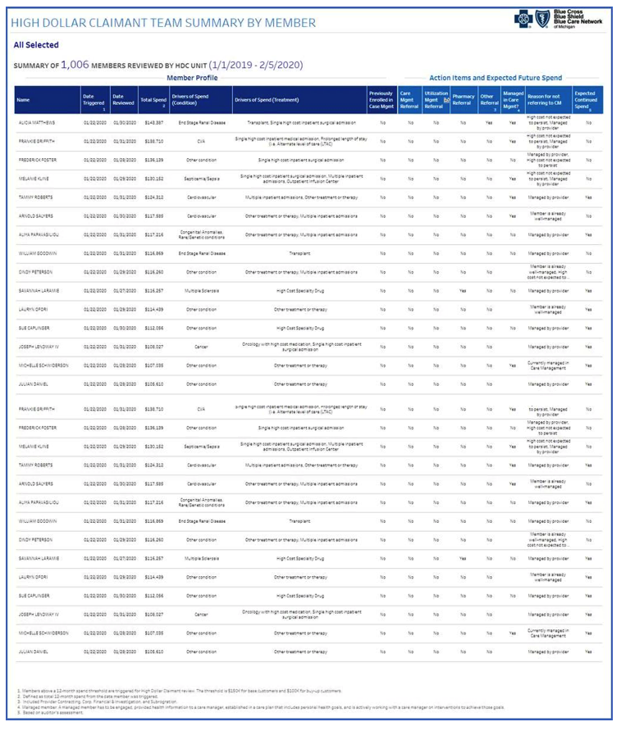
Care management high dollar claimant report
Through SBP 19158 Care Management
Re-Design, the Informatics Team delivered, in an Agile approach, the High Dollar Claimant Report.
This report is designed to be presented to our Group Customers to provide pro-active communication on High Dollar Claimants and the opportunities for Care Management engagement.
New Capabilities Enabled:
This project brought three new capabilities into our Tableau Reporting toolkit:
1. Ability to Burst reports and send to Content Manager for the business
2. Ability to select pages to export to PDF
3. New Landing Page for the business to select groups, divisions, etc. to have an on-demand report to be created

Slide 19
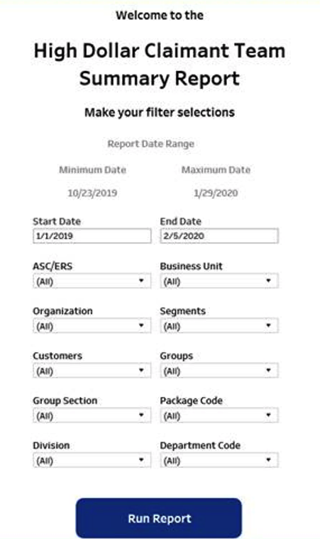
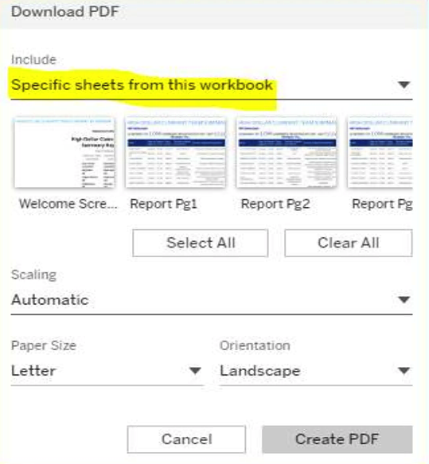
Care management high dollar claimant report
Landing Page for easy access for the business to select with Group, Segments,
Organization, Subgroup, Business Unit, Division, etc.
Ability to select which pages in a report to export to a PDF.

Slide 20
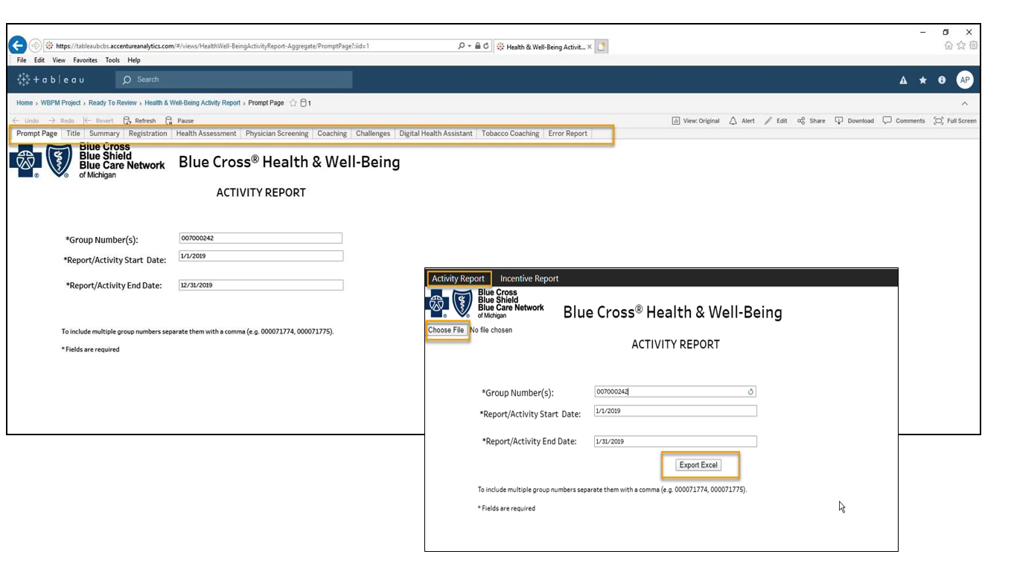
Well being reporting
Through SBP 19151 Well-Being Reporting, the Informatics team has enable a new capability for the business to be able to export Tableau Dashboards to Excel. This was created to meet the business requests from the Group Customers. Note the project is not closed at this time; however, the capability has been created and is now available to be leveraged by other initiatives.
New Capabilities Enabled: Ability to export multi-tabbed Tableau Dashboards to Excel

Slide 21
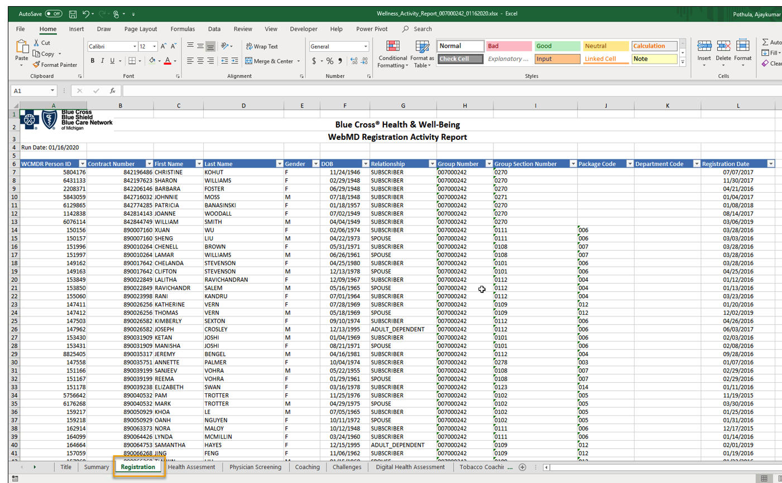
Well being reporting

Slide 22
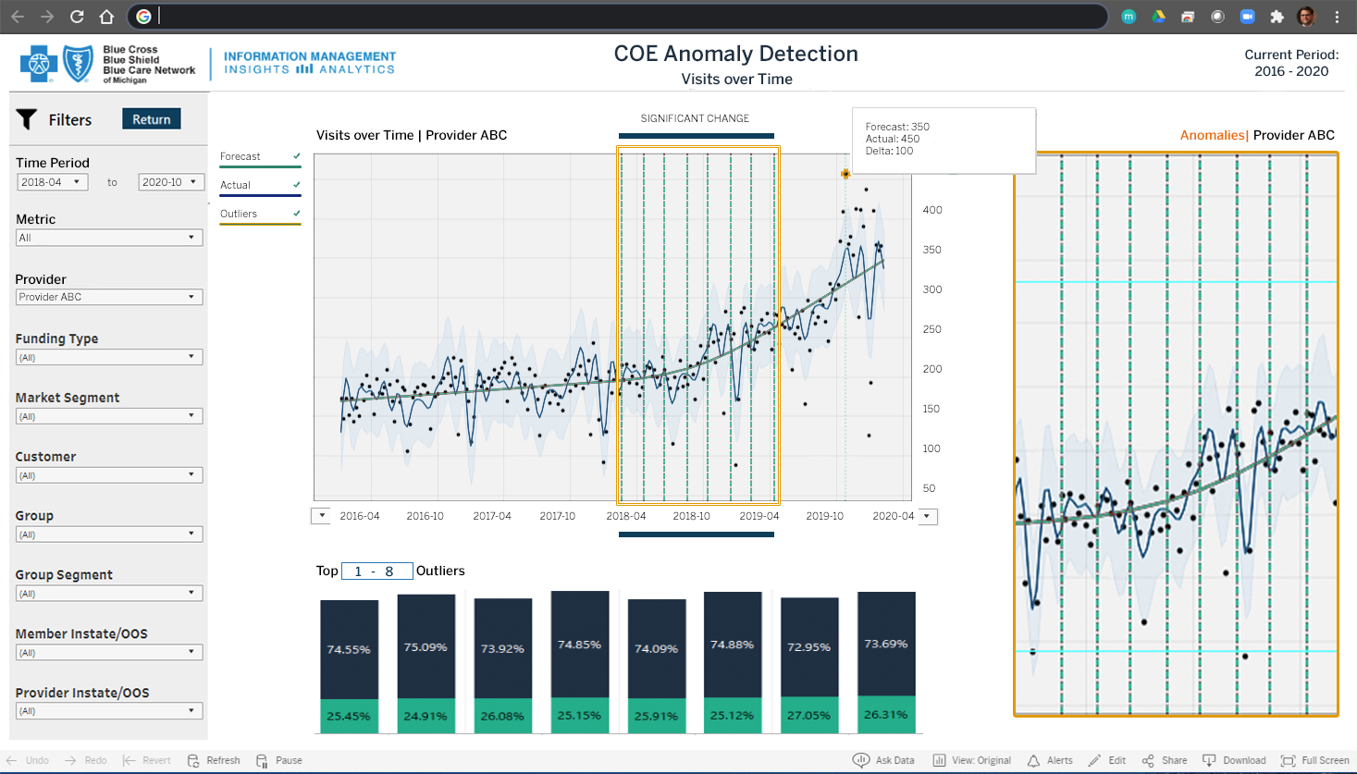
Coe anomaly detection poc

