Slide 1

Reporting & analytics
Informatics environment
Tableau Training

Slide 2

agenda
Tableau in the Informatics Environment
Data Sources / Sandboxes
Enterprise Templates
Use Cases / “PURPOSE”
HUE & ALATION
Roles
Examples

Slide 3
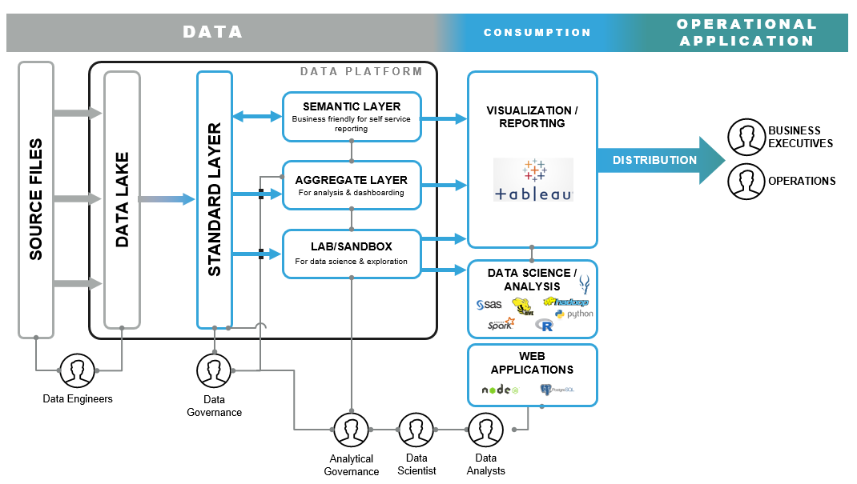
IE Platform Architecture
The IE architecture fosters seamless integration between Informatics and the business by allowing full data
and analytical governance with customization and flexibility for the business.

Slide 4
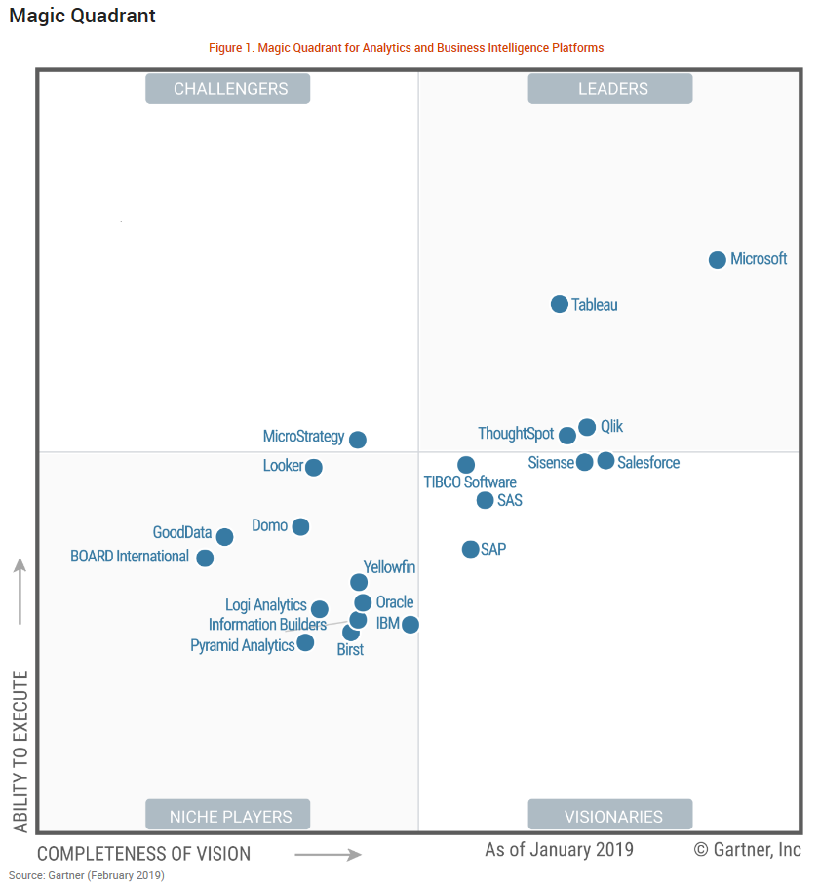
Reporting Tools Overview
In the Informatics Environment, we are currently leveraging Tableau for reporting and visualization. Tableau was selected based on feedback from Gartner, Accenture, as well as internal research and feedback. Although, as an Enterprise we may look to add tools in the IE, our intended approach is capability-based. Our intention is to keep the footprint from a tools perspective as minimum as possible while delivering the capabilities needed to support and drive the business.
Key Features of Tableau:
Drag and drop report creation
Drill down capability to see underlying data
(summary or detail)
Geospatial visualizations
Ability to share dashboards
Dashboard commenting
– add context when sharing or presenting
Integration with Alation
Translation between queries to dashboards
Ability to have multiple filtering criteria on dashboards
Email notifications
Trend Analysis
4

Slide 5
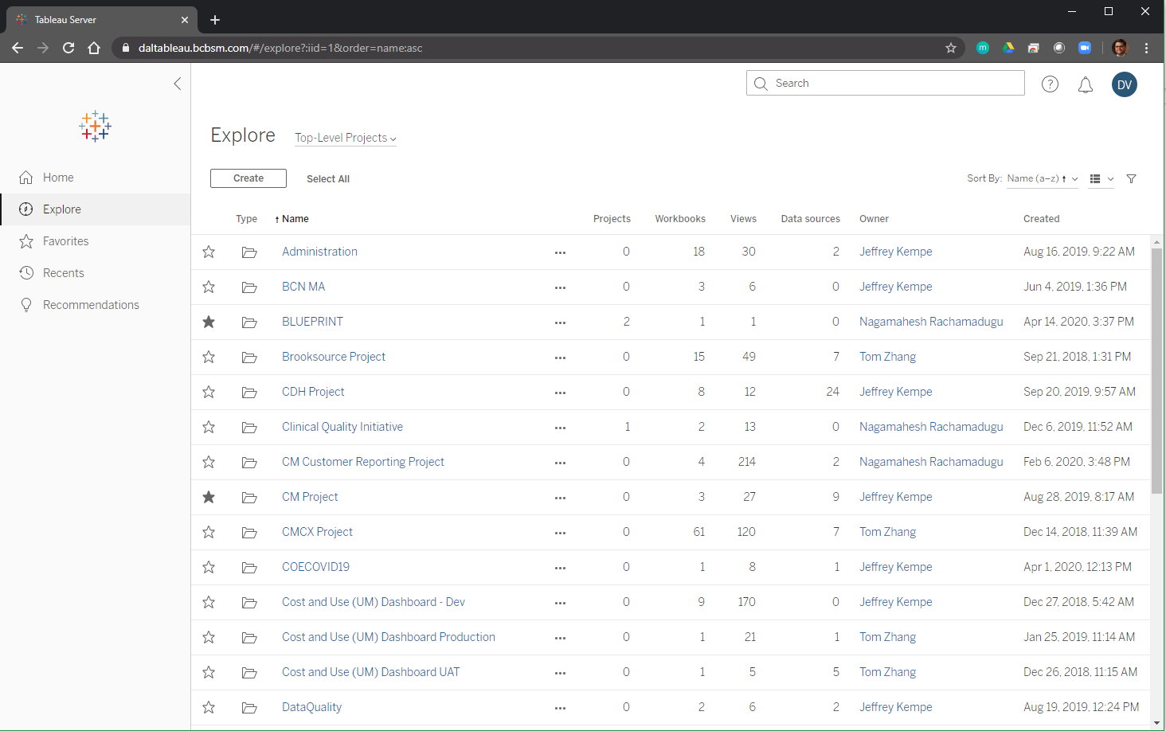
Tableau – 2019.4
5

Slide 6
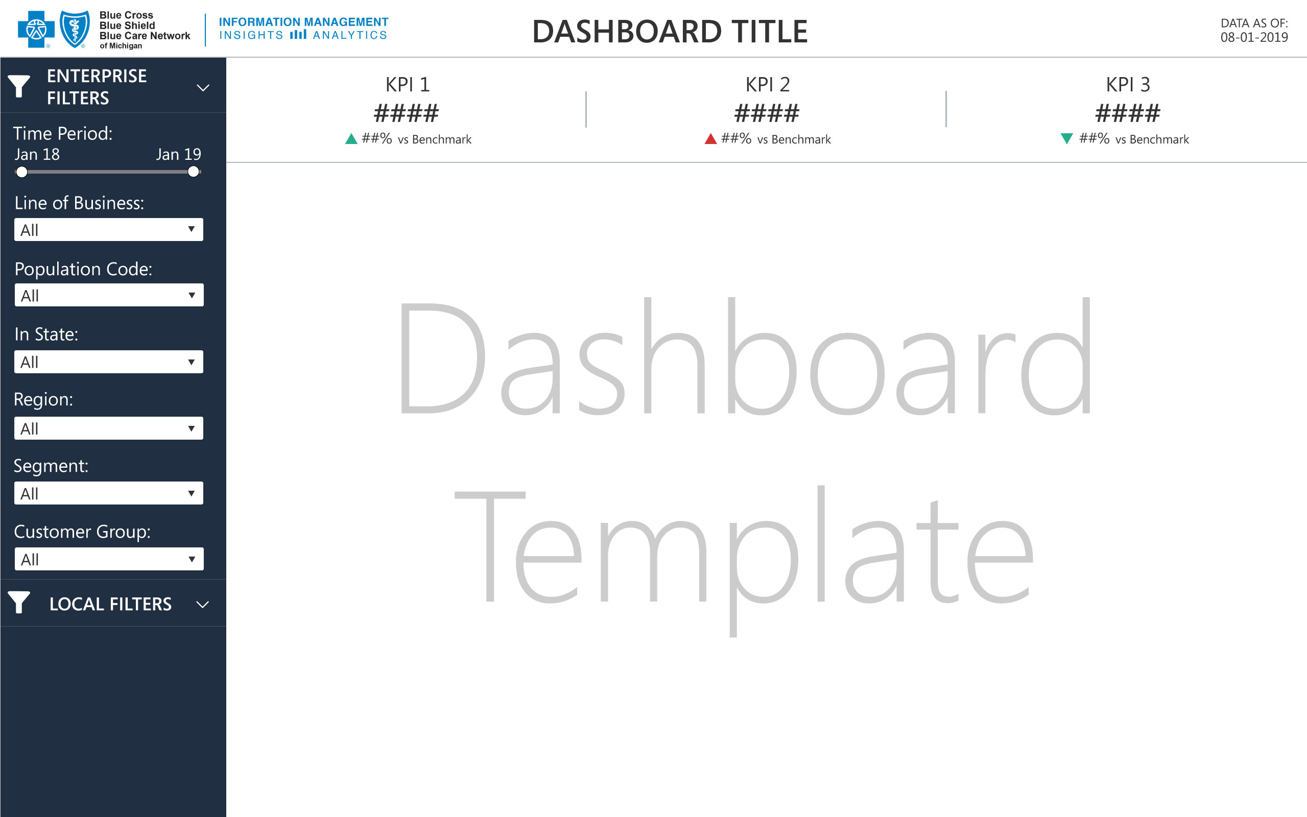
Enterprise templates
Notes:
Global Parts Manufacturer, many plants in many countries
Different source systems
Varying Network Capabilities

Slide 7
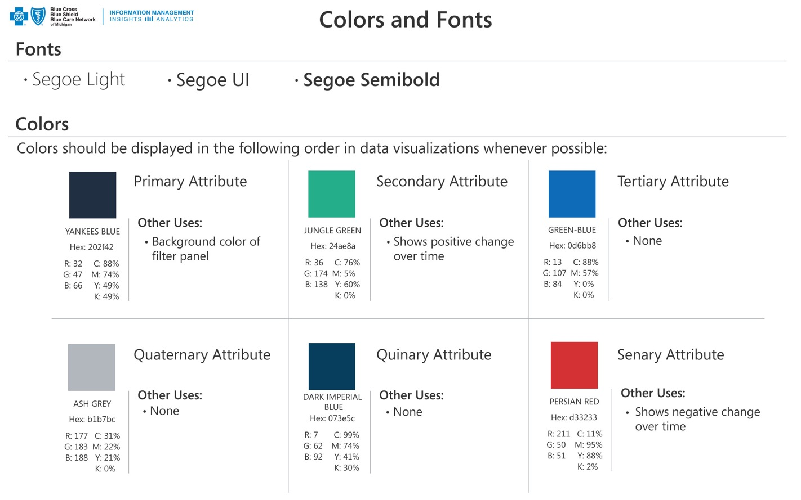

Enterprise style guide
BLUE CROSS AND BLUE SHIELD OF MICHIGAN | STYLE GUIDE SAMPLE

Slide 8
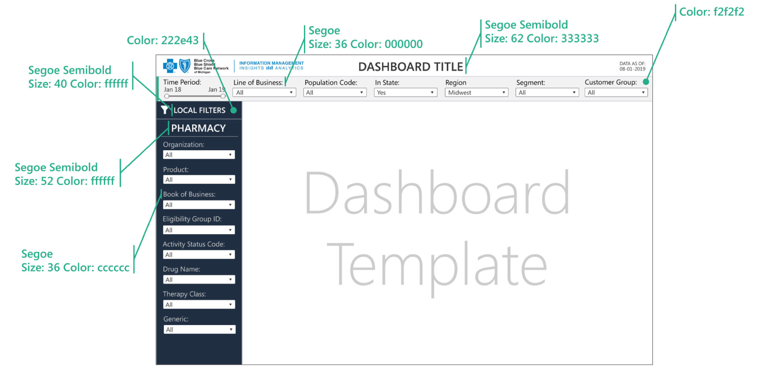
Enterprise style guide

Slide 9
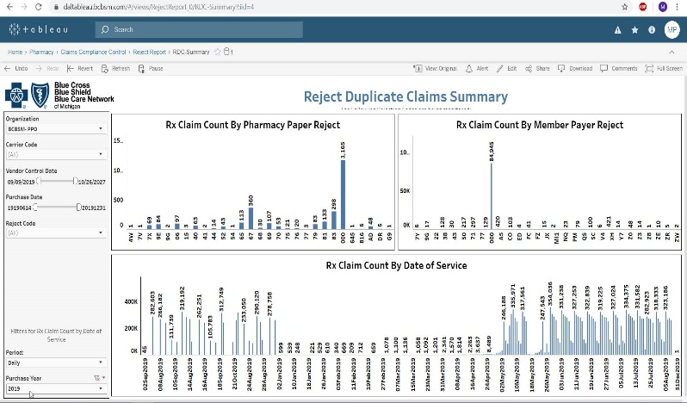

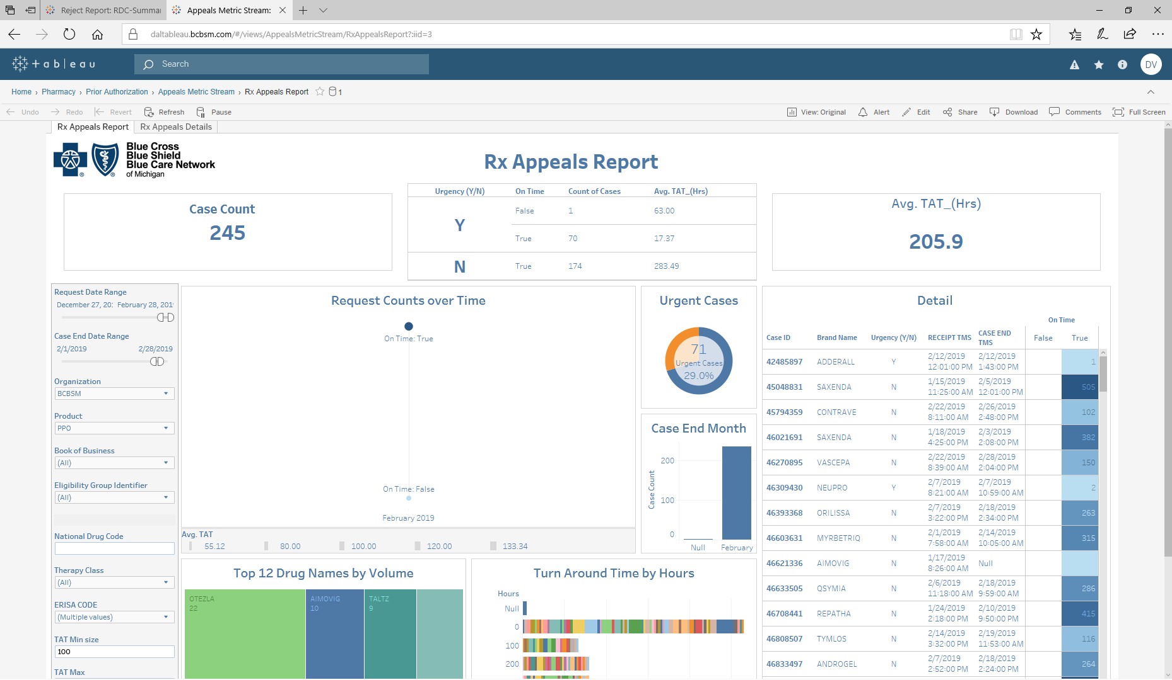
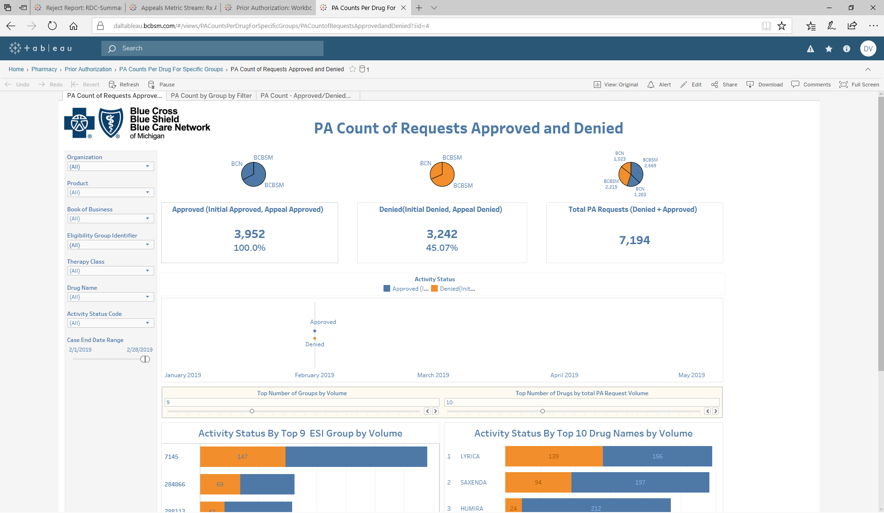
Use case examples
Tableau Demo & Walk Through
Defect Duplicate Claims Summary
Purpose: Identify Rx Claim Count By Pharmacy Paper Reject, By Member Payer Reject, By Count By Data of Service
Appeals Metrics
Purpose: Identify all cases for appeals, help evaluate the effectiveness of current prior Authorization programs
PA Count
Purpose: Capture and evaluate Prior Authorizations data to support customer retention

Slide 10
Current State : Appeals Metrics
CASE ID | BRAND NAME | ACTIVITY STATUS | URGENT/NON URGENT | ERISA CD | Finalized Month | URGENT TMS | END TMS | RECEIPT DT | On Time | TAT
44119193 | BELVIQ 10 MG TABLET | Denied on Ap | Urgent | 2 | 4 | 20-Apr-18 | 22-Apr-18 | 20-Apr-18 | Yes | 2
43999747 | XIFAXAN 550 MG TABLET | Denied on Ap | Urgent | 2 | 4 | 25-Apr-18 | 27-Apr-18 | 25-Apr-18 | Yes | 2
43725056 | H.P. ACTHAR 80 UNIT/ML VIAL | Denied on Ap | Urgent | 2 | 4 | 5-Apr-18 | 6-Apr-18 | 5-Apr-18 | Yes | 1
43996385 | VYTORIN 10 MG-20MG TABLET | Denied on Ap | Urgent | 2 | 4 | 12-Apr-18 | 13-Apr-18 | 12-Apr-18 | Yes | 1
44002791 | OMEPRAZOLE 40 MG CAPSULE DR | Denied on Ap | Urgent | 2 | 4 | 5-Apr-18 | 6-Apr-18 | 5-Apr-18 | Yes | 1
43914085 | LYRICA 75 MG CAPSULE | Denied on Ap | Urgent | 2 | 4 | 6-Apr-18 | 6-Apr-18 | 6-Apr-18 | Yes | 0
43717537 | METAXALONE 800 MG TABLET | Denied on Ap | Urgent | 2 | 4 | 24-Apr-18 | 24-Apr-18 | 24-Apr-18 | Yes | 0
43666633 | DUPIXENT 300 MG/2ML SYRINGE | Denied on Ap | Urgent | 2 | 4 | 23-Apr-18 | 23-Apr-18 | 23-Apr-18 | Yes | 0
44561103 | XIFAXAN 550 MG TABLET | Denied on Ap | Urgent | 2 | 5 | 16-May-18 | 18-May-18 | 15-May-18 | Yes | 2
44485640 | FARYDAK 20 MG CAPSULE | Denied on Ap | Urgent | 2 | 5 | 15-May-18 | 17-May-18 | 15-May-18 | Yes | 2
44320617 | CIALIS 5 MG TABLET | Denied on Ap | Urgent | 2 | 5 | 29-May-18 | 30-May-18 | 29-May-18 | Yes | 1
44759521 | NEXIUM 40 MG CAPSULE | Denied on Ap | Urgent | 2 | 5 | 24-May-18 | 24-May-18 | 24-May-18 | Yes | 0
44554926 | XIFAXAN 550 MG TABLET | Denied on Ap | Urgent | 2 | 5 | 11-May-18 | 11-May-18 | 11-May-18 | Yes | 0
44318558 | HARVONI 90MG-400MG TABLET | Denied on Ap | Urgent | 2 | 5 | 25-May-18 | 25-May-18 | 25-May-18 | Yes | 0
44550171 | AMITIZA 8 MCG CAPSULE | Denied on Ap | Urgent | 2 | 5 | 18-May-18 | 18-May-18 | 18-May-18 | Yes | 0
44689263 | TALTZ AUTOINJECTOR 80 MG/ML AU | Denied on Ap | Urgent | 2 | 5 | 25-May-18 | 25-May-18 | 25-May-18 | Yes | 0
44358781 | EUCRISA 2 % OINT. (G) | Denied on Ap | Urgent | 2 | 5 | 11-May-18 | 11-May-18 | 11-May-18 | Yes | 0
44058674 | ESOMEPRAZOLE MAGNESIUM 40 MG C | Denied on Ap | Urgent | 2 | 5 | 7-May-18 | 7-May-18 | 7-May-18 | Yes | 0
Purpose: Identify all cases for appeals and help evaluate the effectiveness of current prior Authorization programs

Slide 11

Future State

Slide 12
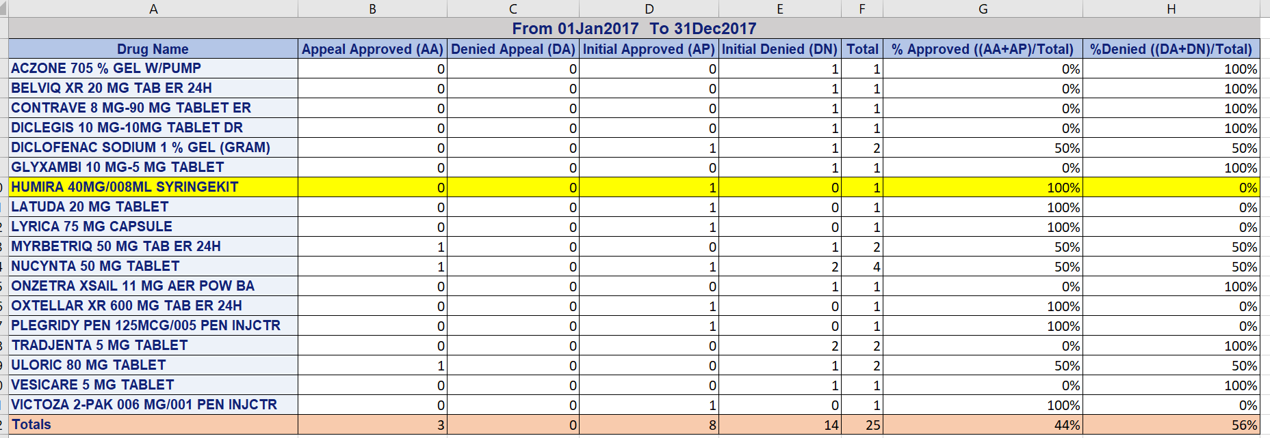
Current State : PA Count Report
Purpose: Capture and evaluate Prior Authorizations data to support customer retention

Slide 13
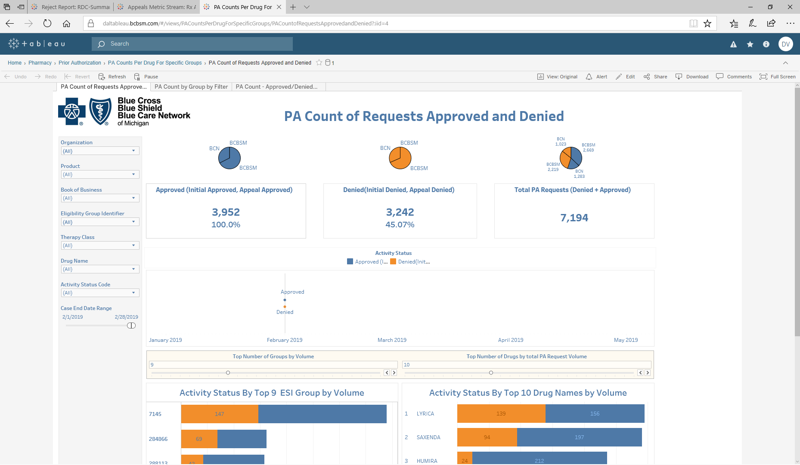
Future State

Slide 14
Current State : Defect Duplicate Claims Summary
Purpose:Identify Rx Claim Count By Pharmacy Paper Reject,
By Member Payer Reject, By Count By Data of Service

Slide 15
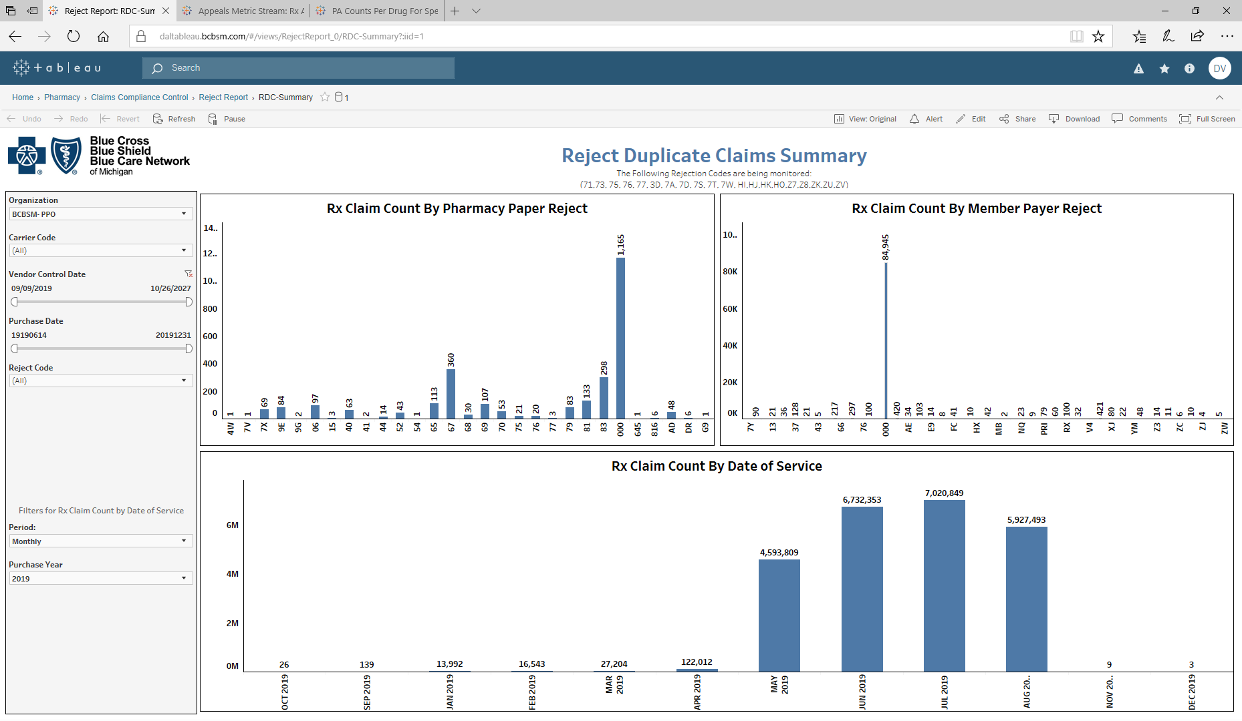
Future State

Slide 16
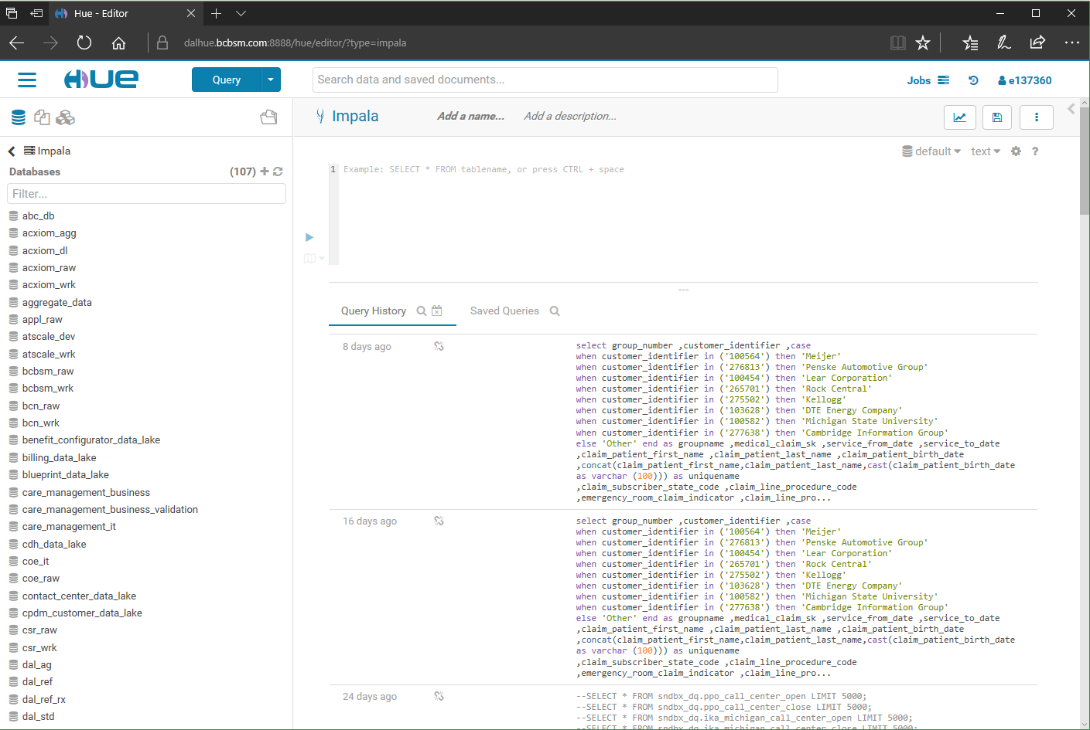
HUE

Slide 17
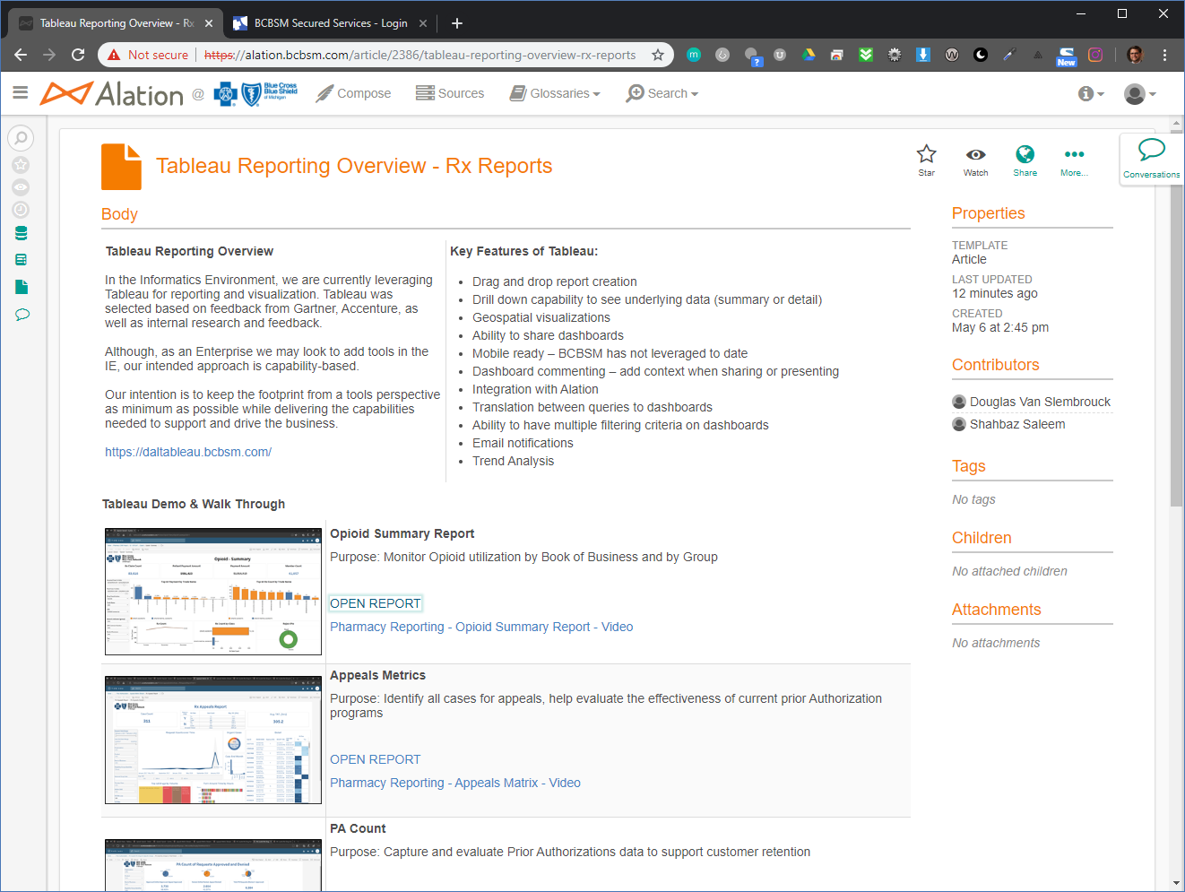
Alation

Slide 18



Use Case & Workflow – Tableau User Types
Organizational Role | Functional Role
Senior Leadership: VPs, Directors | View and interact with dashboards and visualizations in a secure, easy-to-use platform. Filter your data to support your decision making. Download your custom reports. Configure, scale, and create reports based on established layouts. Build worksheets and reports.
Managers, Delivery Leads, Team Leads, Data Analysts | Explore trusted data and answer your own questions faster with full self-service analytics. Configure, scale, and create reports based on established layouts.
Developers | Build data connections, worksheets, and reports.

Slide 19
Reporting & analytics
Informatics environment
product showcase

Slide 20
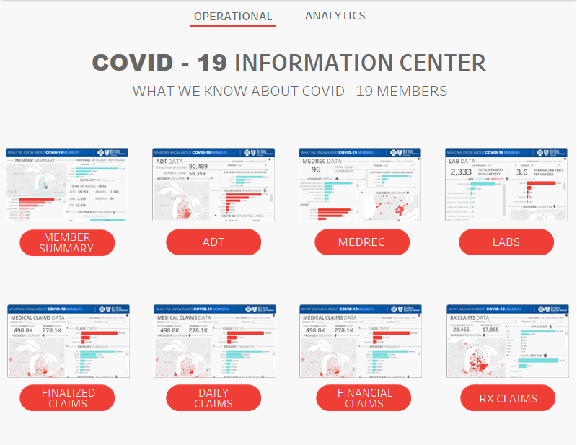
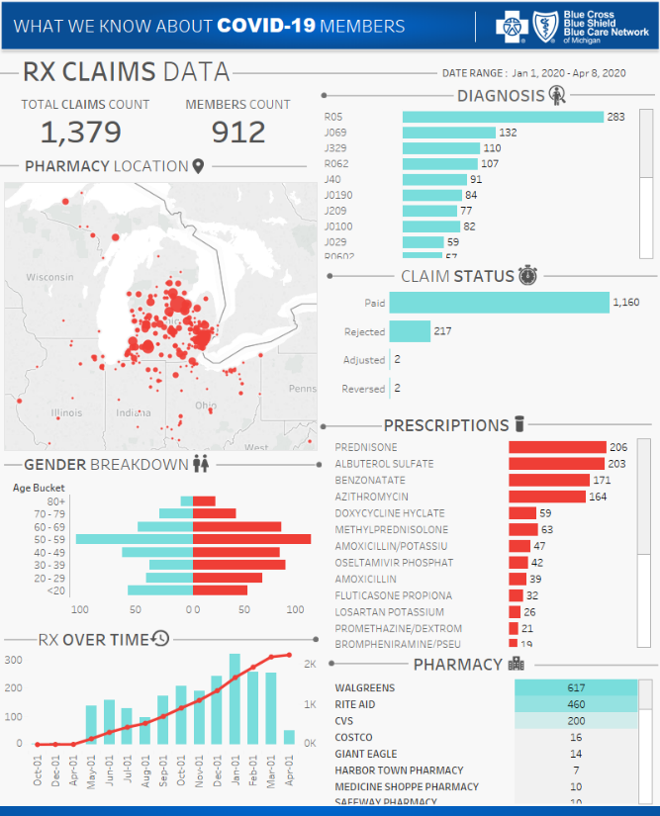
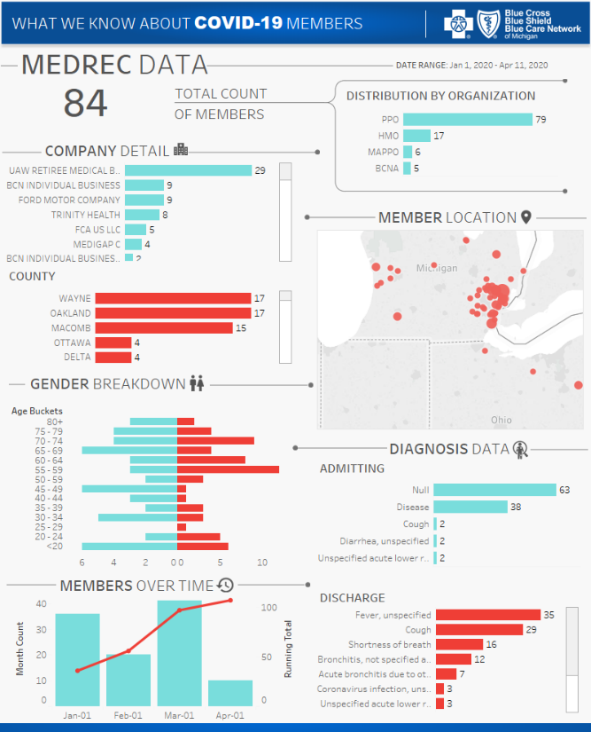
Covid-19

Slide 21
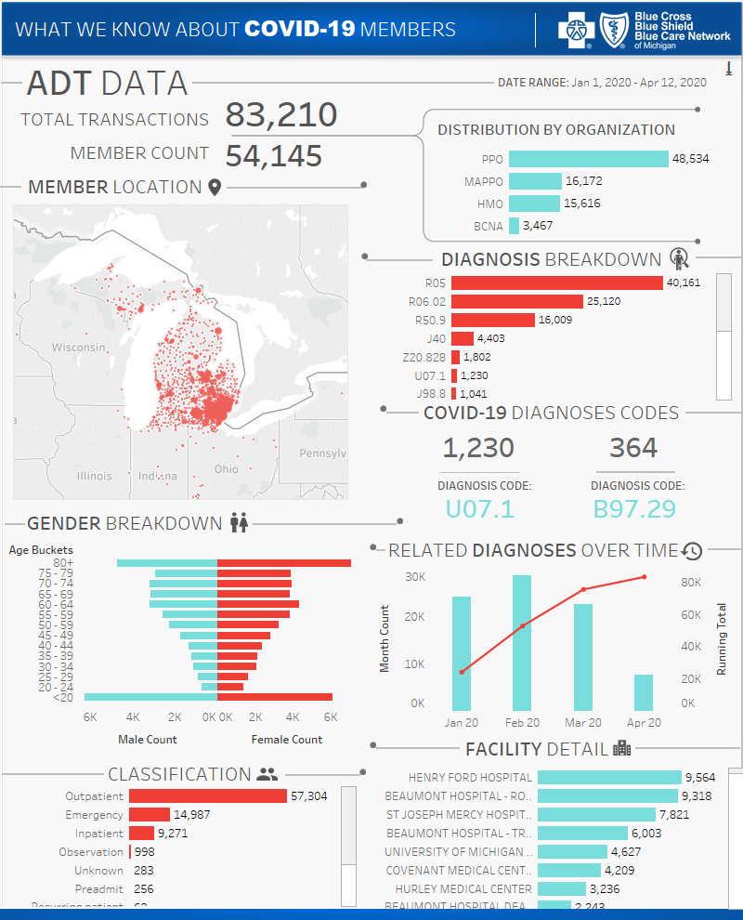
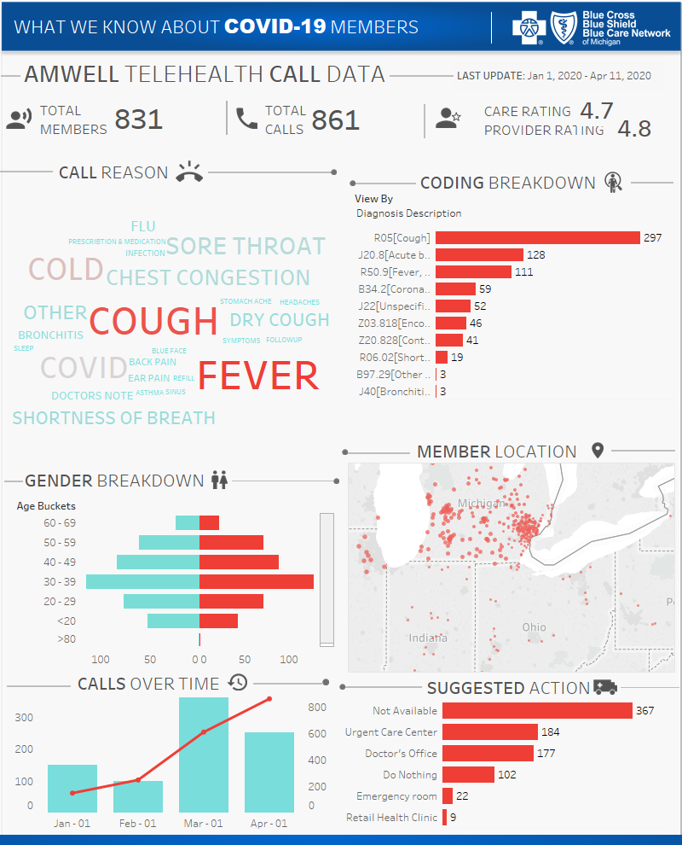
Covid-19

Slide 22
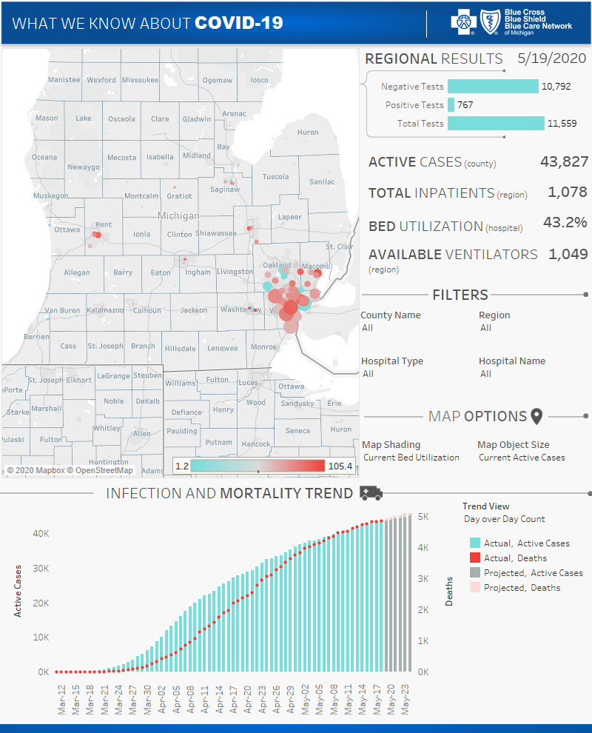
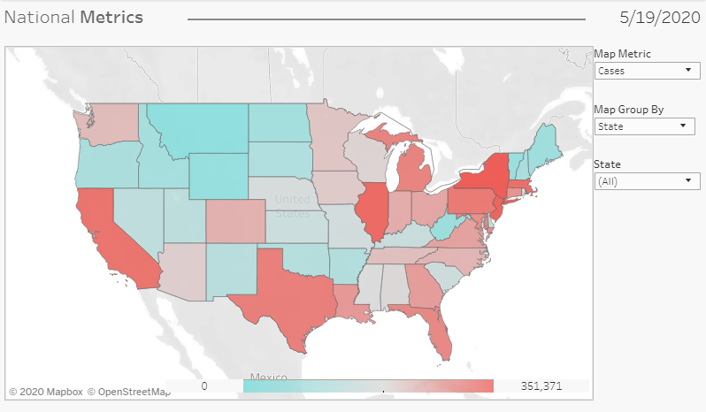
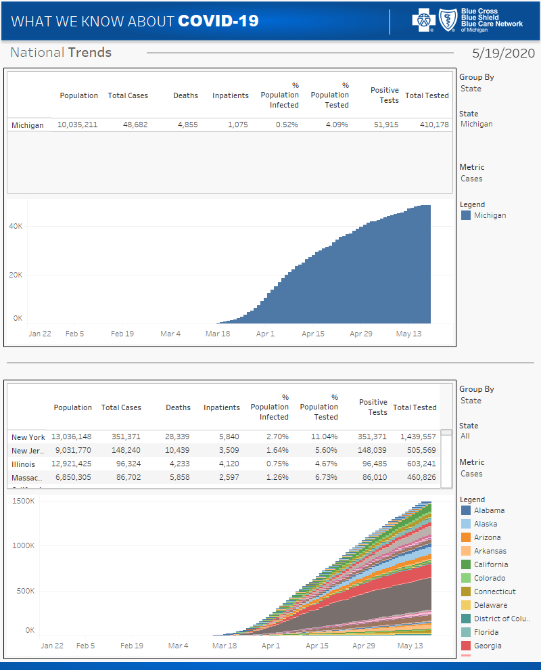
Covid-19

Slide 23
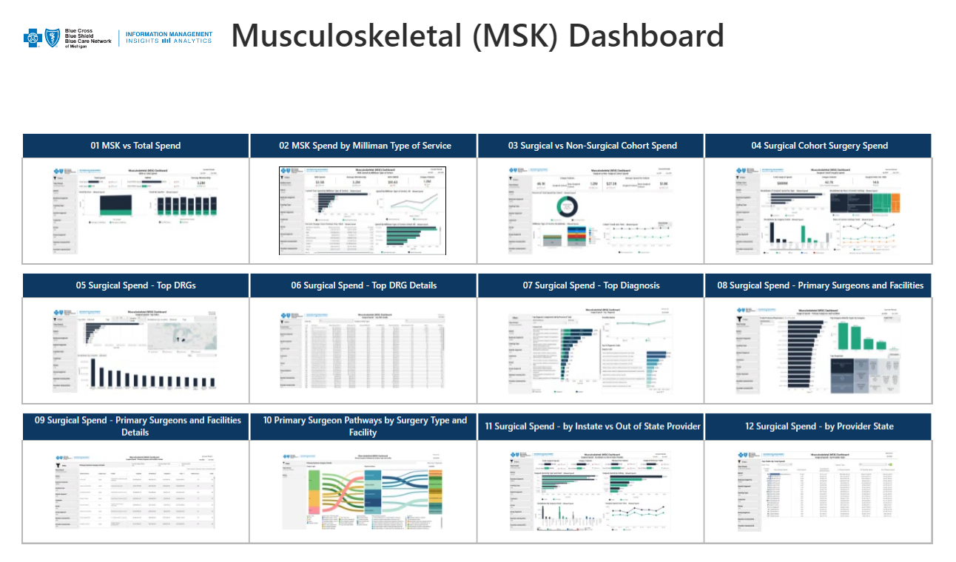
MSK Dashboards - executive summary / landing zone

Slide 24
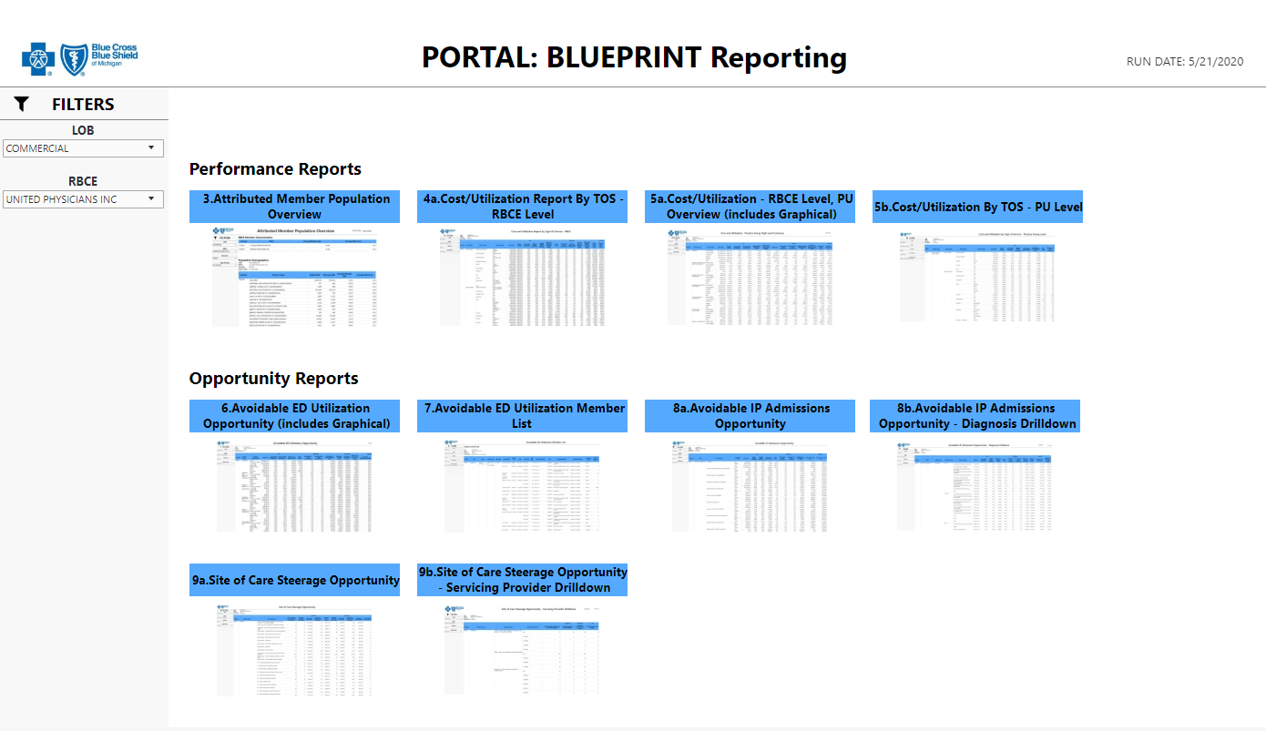
BLUEPRINT – Partner w/ OW to enable reports in Ie

Slide 25
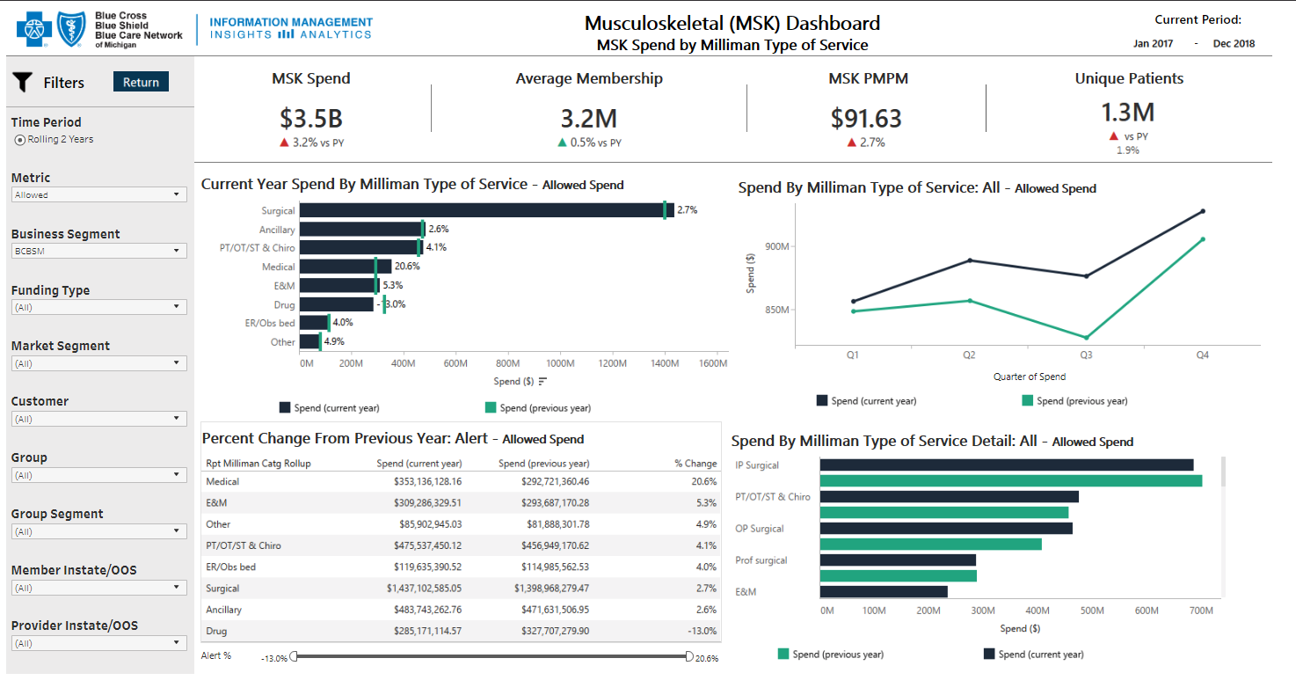
MSK Dashboards

Slide 26
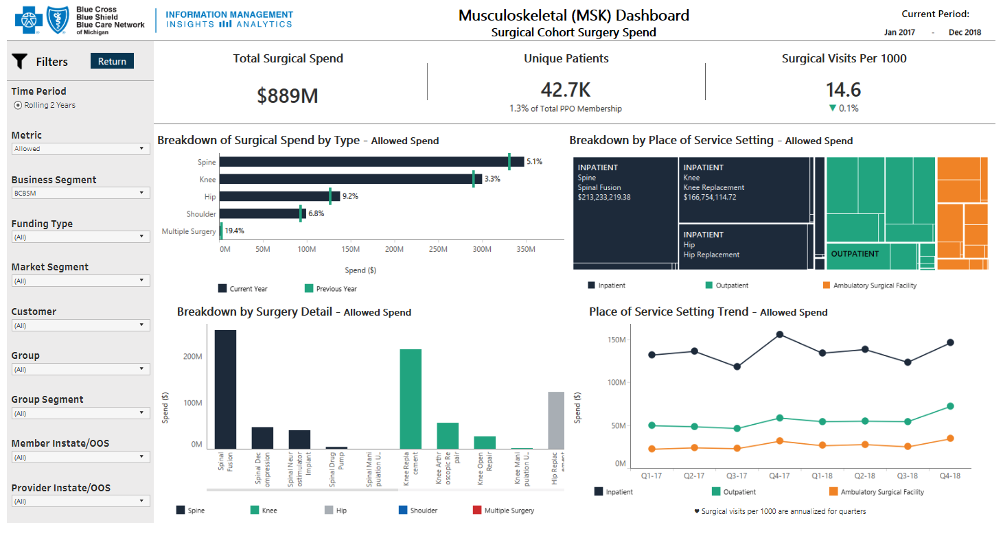
MSK Dashboards

Slide 27
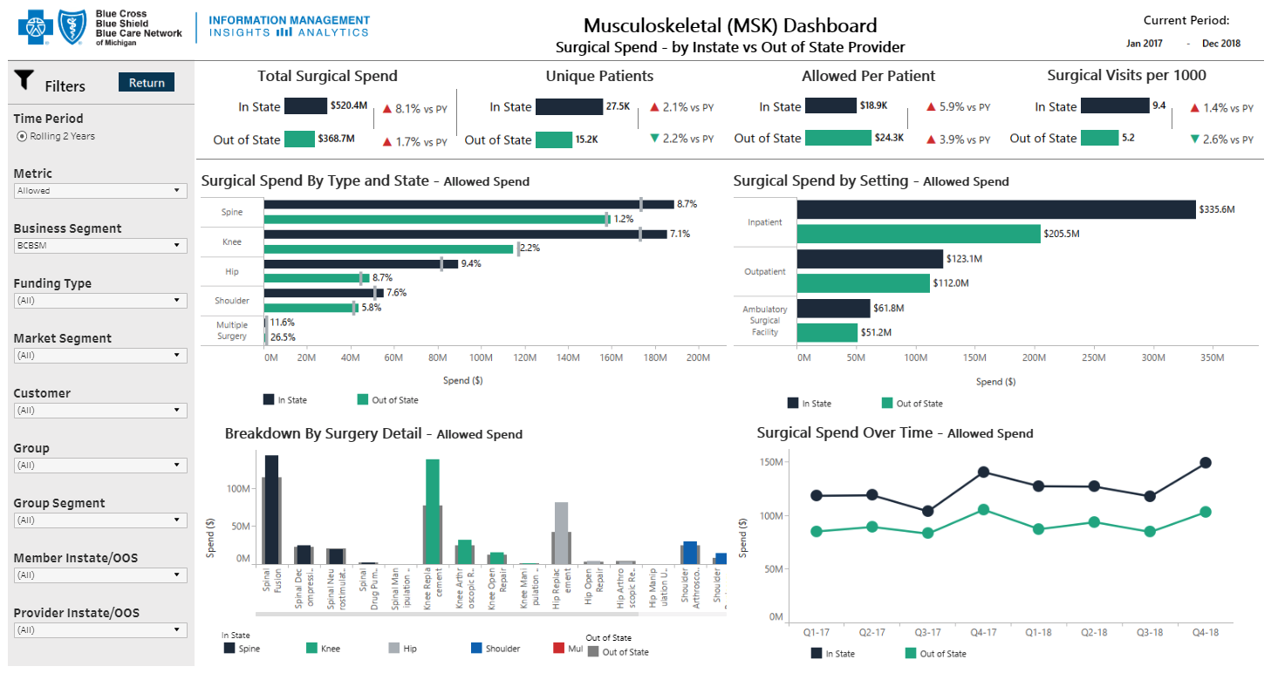
MSK Dashboards

Slide 28
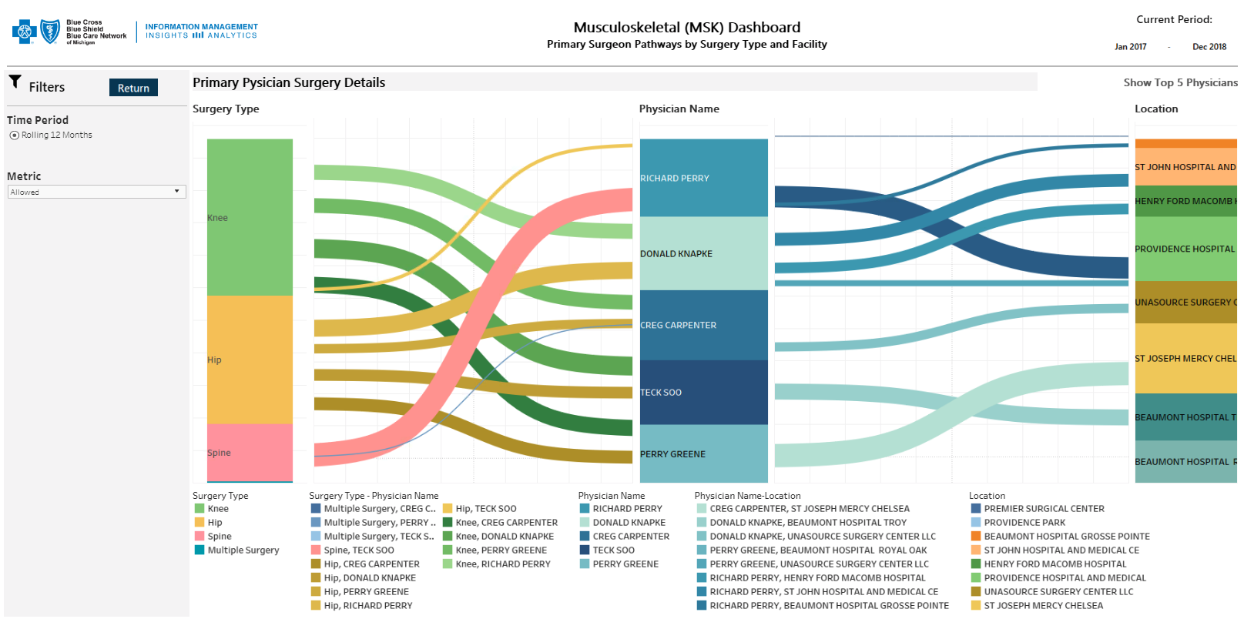
MSK Dashboards

Slide 29
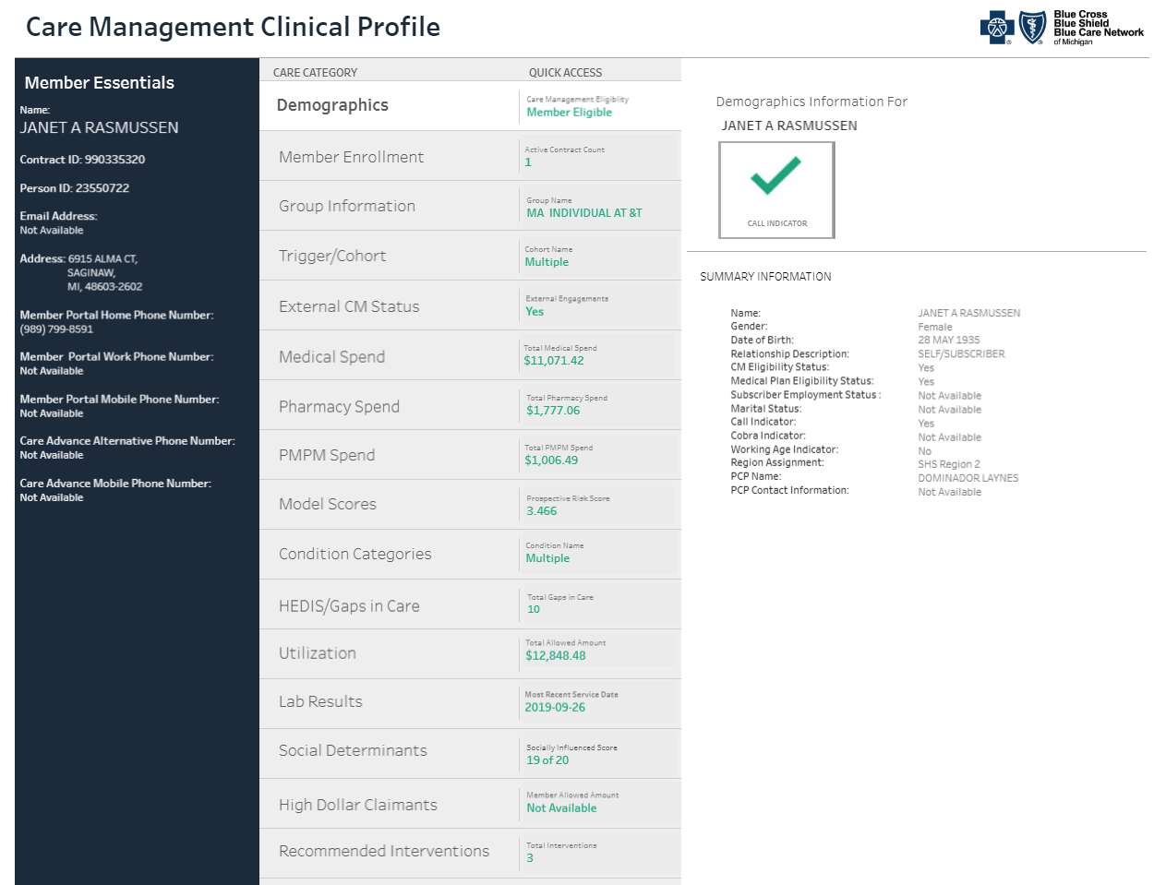
Care management clinical profile (cm360)

Slide 30
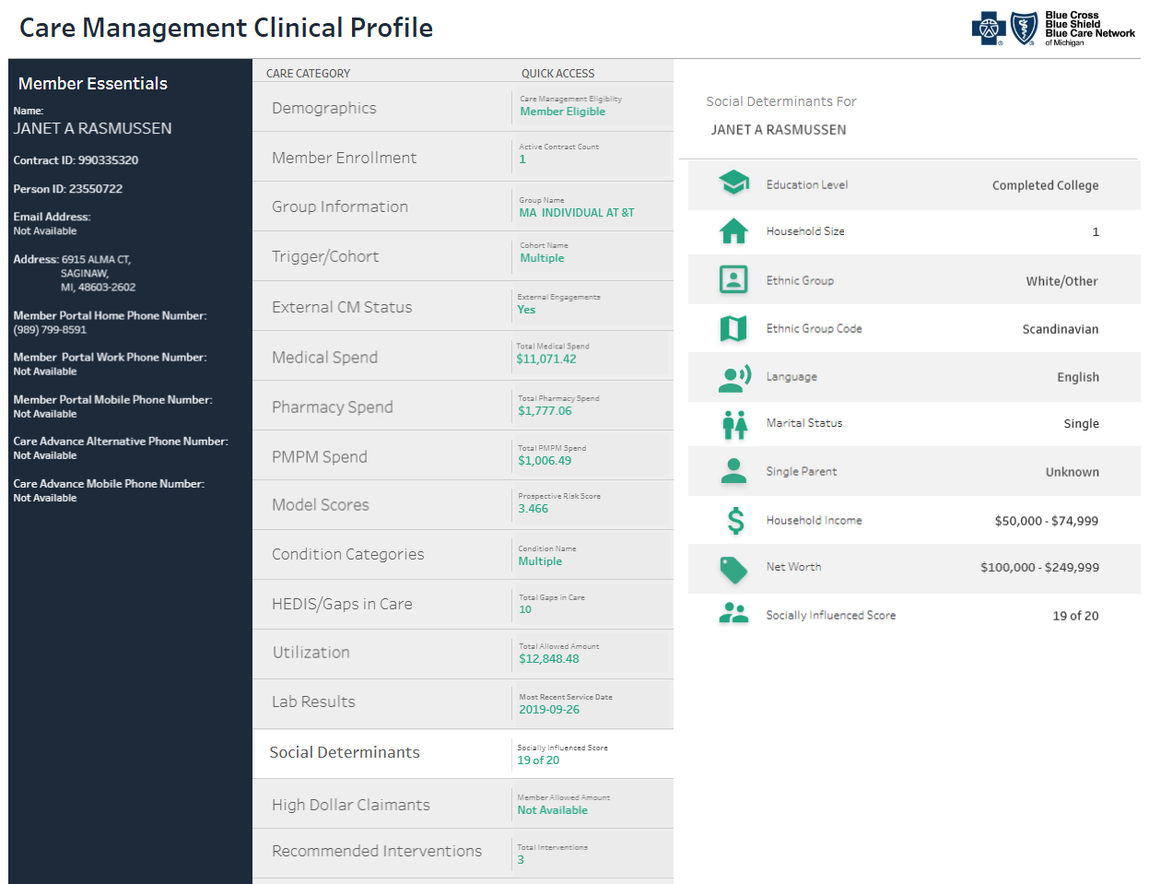
Care management clinical profile (cm360)

Slide 31
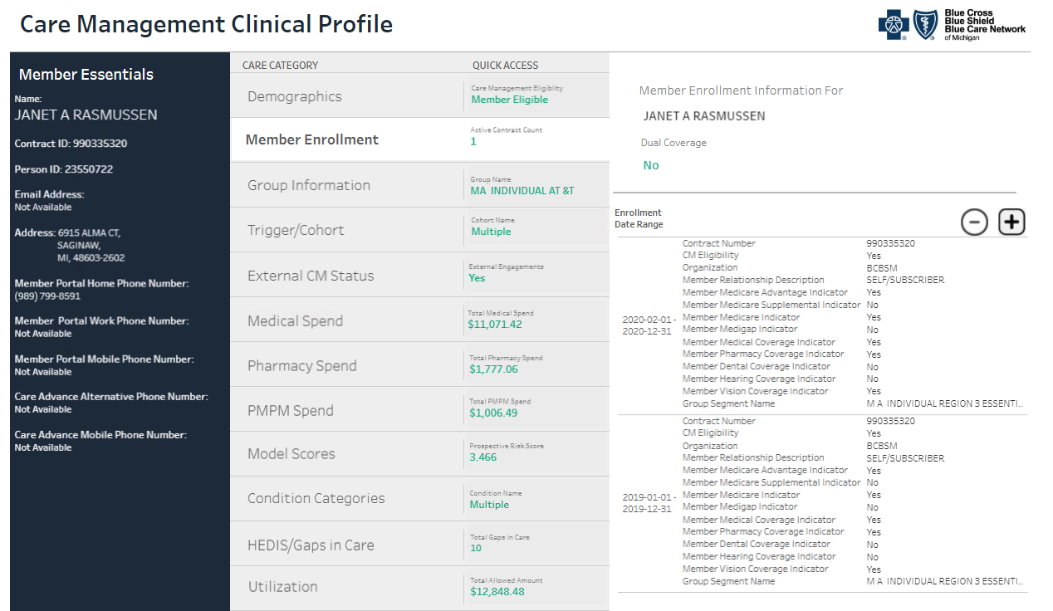
Care management clinical profile (cm360)

Slide 32
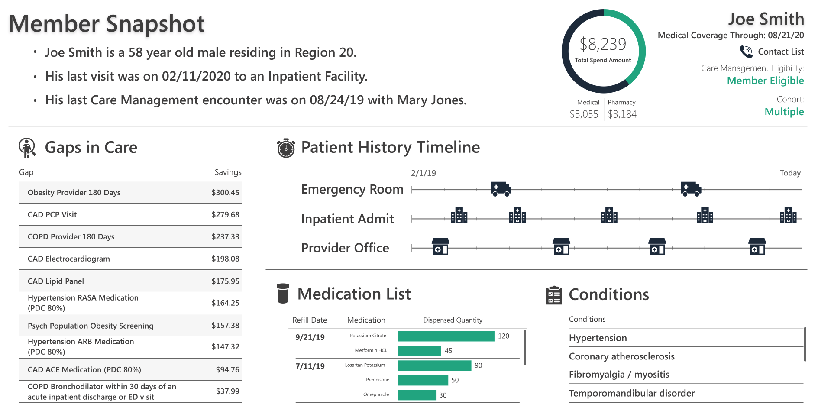
Care management clinical profile (cm360) member summary

Slide 33
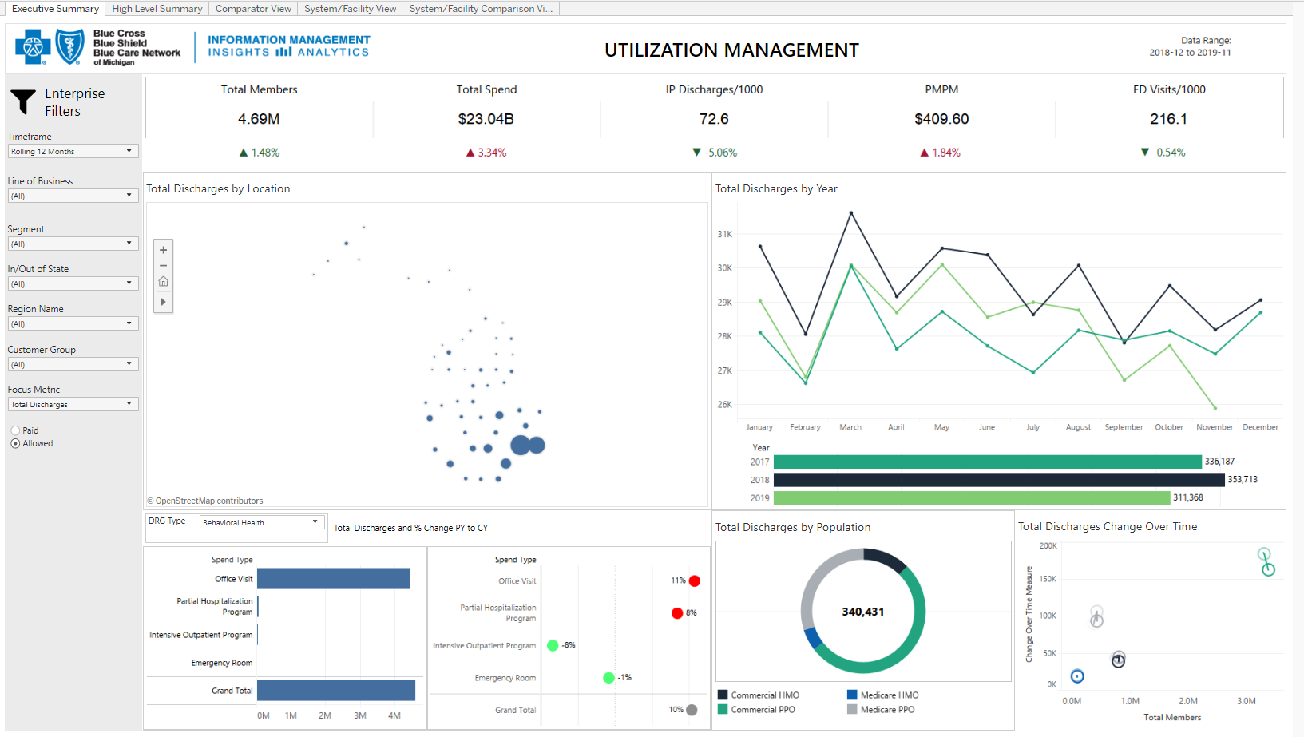
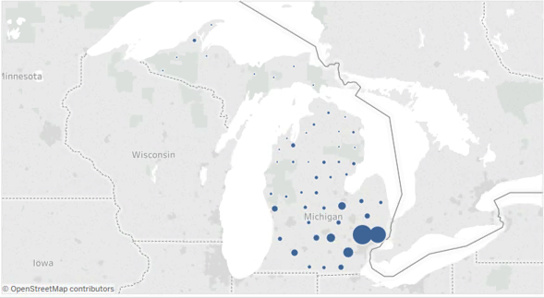
Utilization management

Slide 34
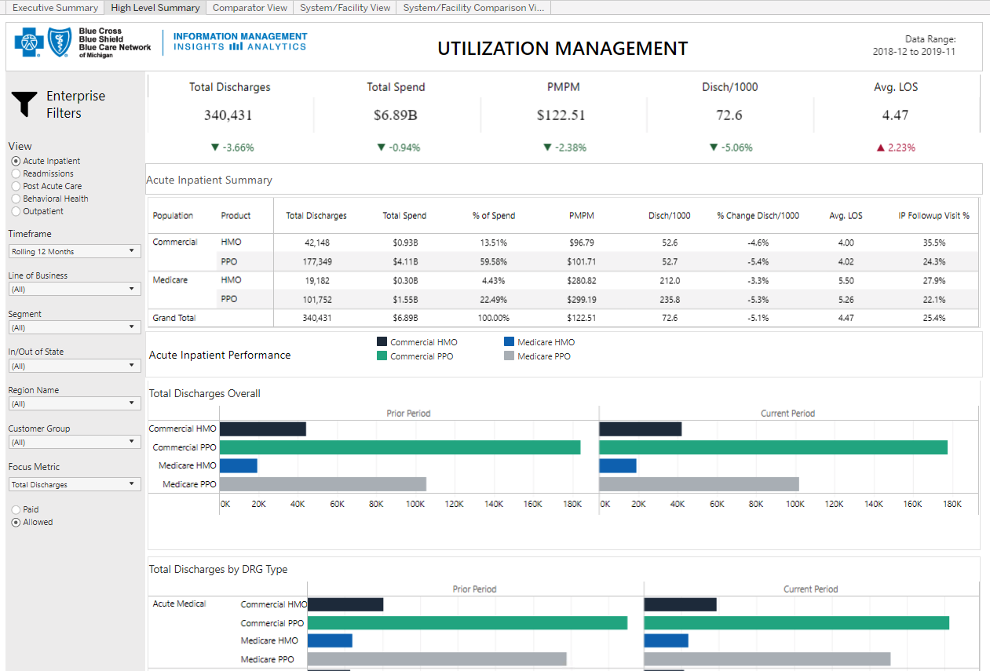
Utilization management

Slide 35
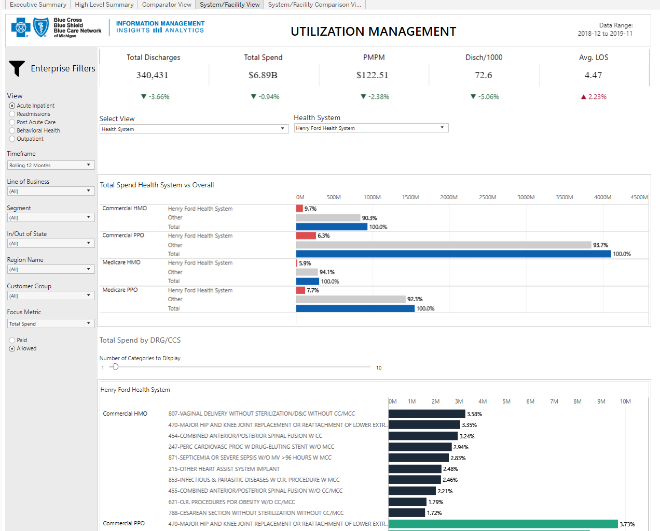
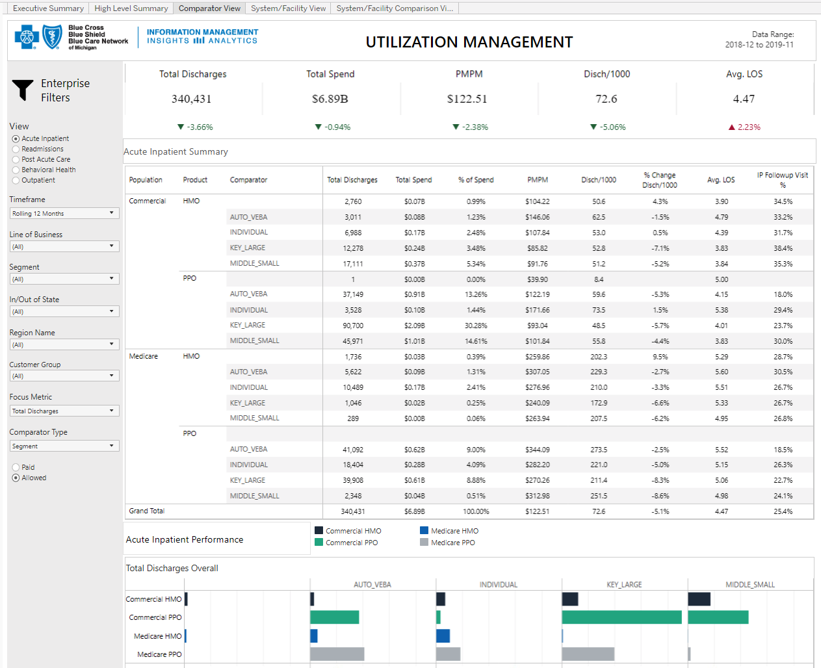
Utilization management

Slide 36
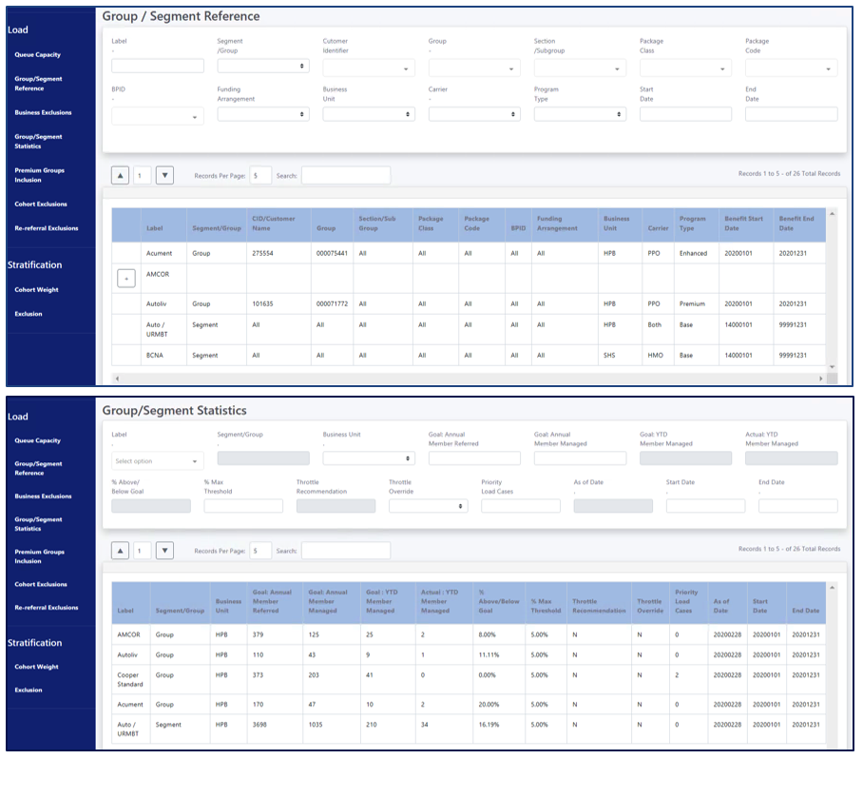
Care management admin screens
The Care Management Admin Screens are built to facilitate the loading and stratification of Care Management members for eligibility in the Care Management Programs.
This custom UI solution was designed, developed and deployed by the IT team in our Web Application Environment by partnering with the business and aligning to their need to create a custom solution.

Slide 37
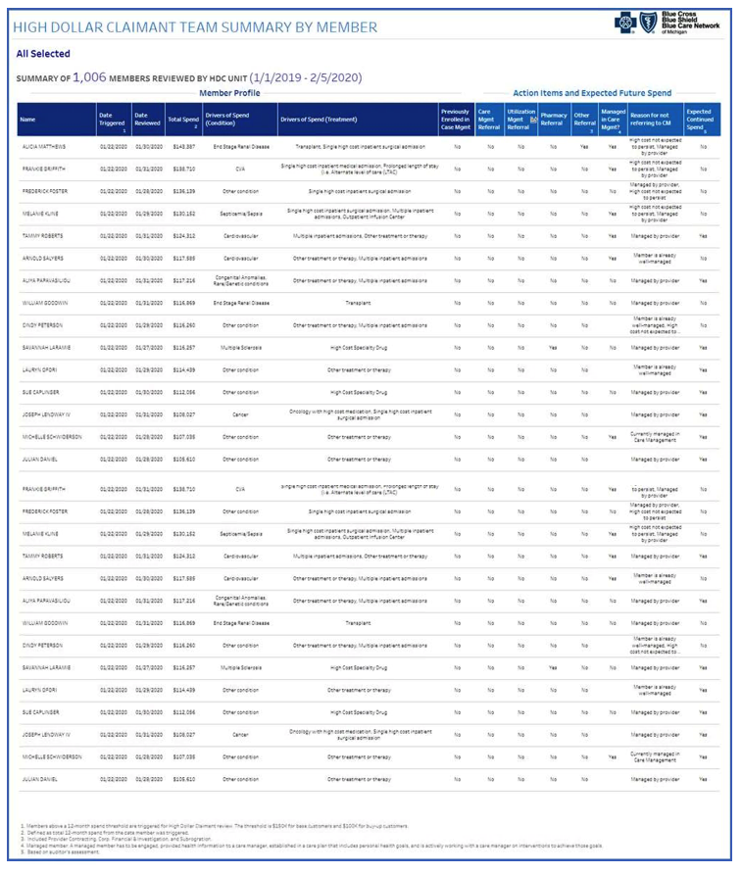
Care management high dollar claimant report
Through SBP 19158 Care Management
Re-Design, the Informatics Team delivered, in an Agile approach, the High Dollar Claimant Report.
This report is designed to be presented to our Group Customers to provide pro-active communication on High Dollar Claimants and the opportunities for Care Management engagement.
New Capabilities Enabled:
This project brought three new capabilities into our Tableau Reporting toolkit:
1. Ability to Burst reports and send to Content Manager for the business
2. Ability to select pages to export to PDF
3. New Landing Page for the business to select groups, divisions, etc. to have an on-demand report to be created

Slide 38
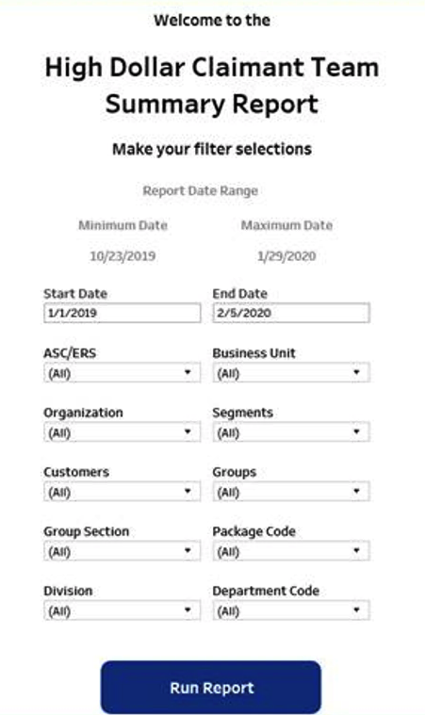
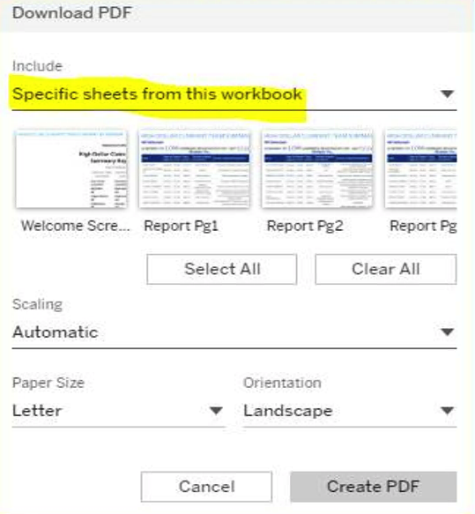
Care management high dollar claimant report
Landing Page for easy access for the business to select with Group, Segments,
Organization, Subgroup, Business Unit, Division, etc.
Ability to select which pages in a report to export to a PDF.

Slide 39
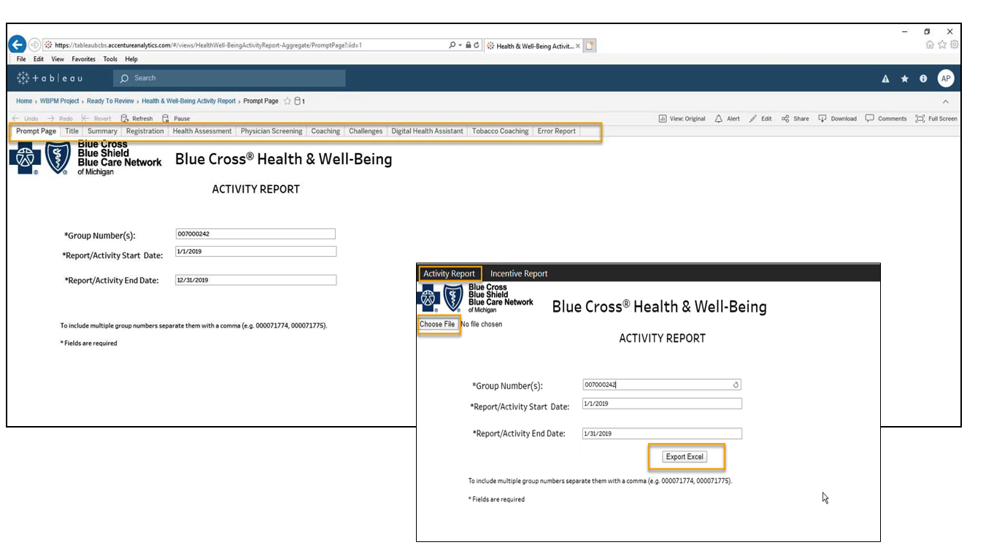
Well being reporting
Through SBP 19151 Well-Being Reporting, the Informatics team has enable a new capability for the business to be able to export Tableau Dashboards to Excel. This was created to meet the business requests from the Group Customers. Note the project is not closed at this time; however, the capability has been created and is now available to be leveraged by other initiatives.
New Capabilities Enabled: Ability to export multi-tabbed Tableau Dashboards to Excel

Slide 40
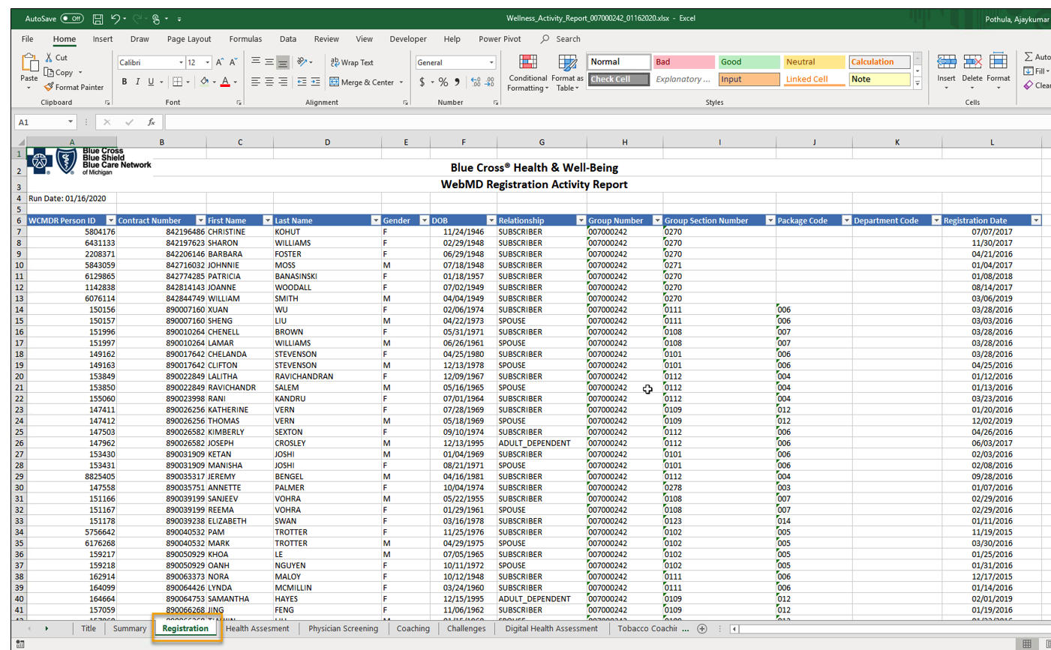
Well being reporting

Slide 41
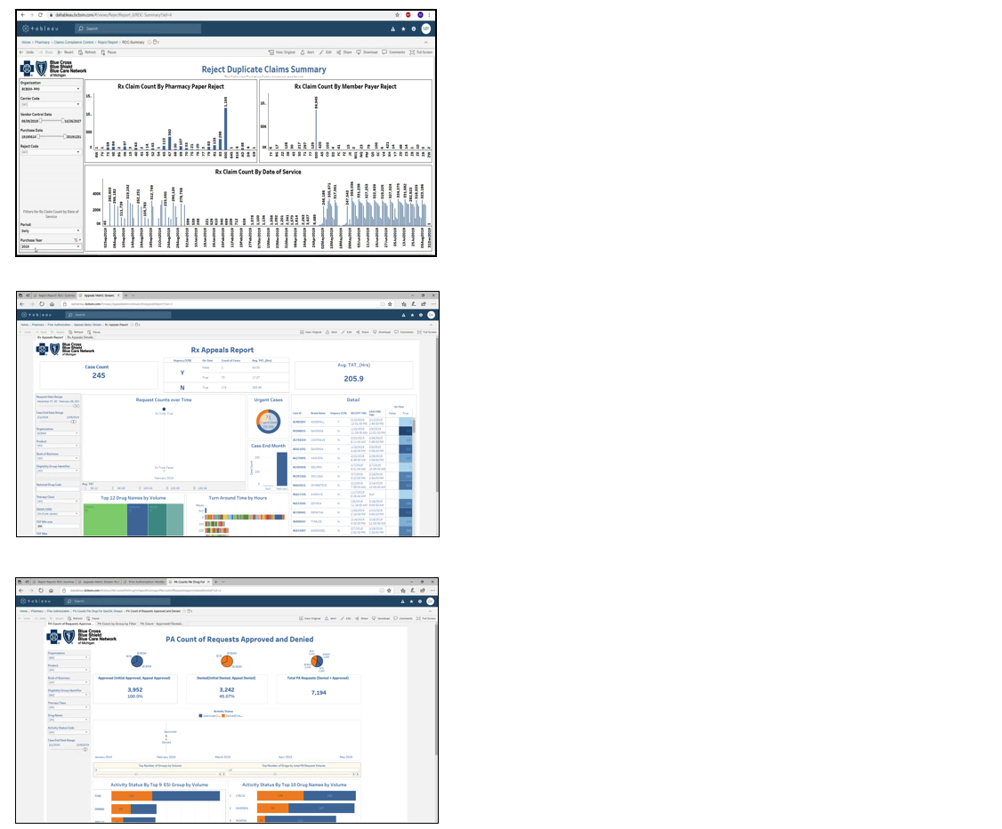
Pharmacy reporting
Defect Duplicate Claims Summary
Purpose: Identify Rx Claim Count By Pharmacy Paper Reject, By Member Payer Reject, By Count By Data of Service
Appeals Metrics
Purpose: Identify all cases for appeals, help evaluate the effectiveness of current prior Authorization programs
PA Count
Purpose: Capture and evaluate Prior Authorizations data to support customer retention

